Slide 1
Race Differences in Intelligence
Jean Hansen, March 2019 www.human-intelligence.org
Richard Lynn
Men… are masters of their fates:
The fault, dear Brutus, lies not in our stars,
But in ourselves, that we are underlings
- William Shakespeare

Slide 2
I prefer an injurious truth to a useful error. Truth heals any pain it may inflict.
- Johann Wolfgang von Goethe

Slide 3
Contents
1. The Main Human Populations/Races
2. What’s Intelligence?
3. I.Q Validity
4. Mean IQ Accross the World
5. Intelligence, Highly Genetic
6. Cause of Racial Differences
7. Why Is not the Whole World Developed?
8. The Worldwide Hierarchy
9. Scientific Accreditation
10. Western Twilight and General Conclusion
Notes:
vgrfb

Slide 4
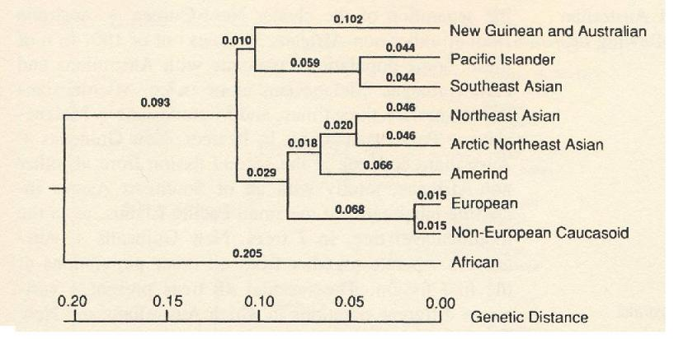
The Main Human Populations/Races
Race, the biological definition:
« Subdivision of a species that inherits characteristics that distinguish it from other populations of the species. In a genetic sense, a race is a population that differ in the incidence of certain genes from other populations, consequence of an isolation, most often geographical. Race is a synonymous of subspecies or genetic clusters »
A race is characterized by a mega-poly-genetic frequency unit.
+ Pygmies and Bushmen (African Subgroup)
Table from "The History and Geography of Human Genes", 2000 Sforza, Menozzi and Piazza distinguish 9 main "genetic clusters" (races) in the homo sapiens species.

Slide 5
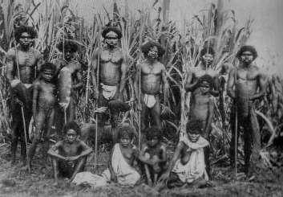
Homo sapiens emerges in Africa 200 thousand years ago.
Africans Homo sapiens would have appeared 200 thousand years ago in Africa Equatorial.
2. South Asians and North Africans (MENA for Middle Easterners and North Africans)
The first groups migrate out of sub-Saharan Africa and colonize Africa from North and
Southwest Asia 100 thousand to 90 thousand years ago. At this level they were isolated
from Africans by distance and by the Sahara Desert and thus evolved into a distinct
race: North African and South Asian.
3. Southeast Asians (Indonesia, Cambodia ...) People from South Asia migrate to Southeast Asia there are about 70,000 years old and evolve
in Southeast Asians.
4. Pacific Islanders Only 6000 years ago, some Southeast Asians began migrating Pacific Islands, where they evolved into a distinct race, the inhabitants of the Pacific Islands or oceanic.
5. Australian Aborigines Some of the peoples of South Asia and East Asia migrate to the islands of the archipelago Indonesian and arrive in New Guinea around 65,000 years ago. There are around 60,000 some of these people migrate to Australia, where they live in Aborigines Australians. A people closely linked genetically live in new guinea.

Slide 6
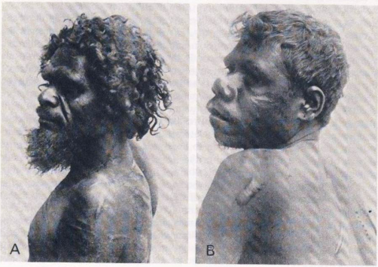
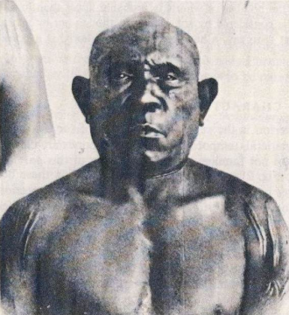
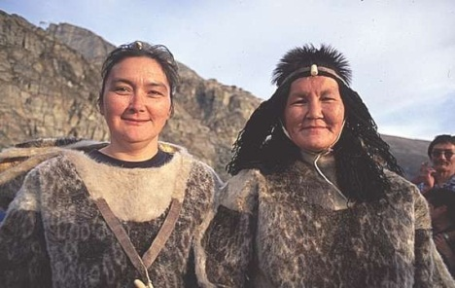
6. Europeans
A number of those who colonized the Near East between 100,000 and 90,000 years ago migrate to the north and about 60,000 years ago and reach the Caucasus, from which they spread in Ukraine, then, about 40,000 years ago, in central and western Europe. Other peoples of Asia Southwest began to colonize southeastern Europe in Anatolia. These people have evolved into Europeans with their pale skin and, in northern Europe, their blond hair and their blue eyes. Europeans were isolated from South Asians and North Africans by the Mediterranean Sea, and to the east by the Black and Caspian Seas, the high mountains of the Caucasus and Himalayas and the Kara Kum desert in Turkmenistan.
7. East Asians (China, Japan, Korea, Taiwan ...)
Southern and Central Asian peoples began to colonize North Asia between -60,000 and
-50,000 years, where they evolved into East Asians. East Asians were isolated Europeans
by the Gobi desert in the west and South Asians by the Himalayas to the south.
8. Arctic People
Between -50,000 and -40,000 years of the peoples of Asia migrate to the far north
of Asia where they evolve into Eskimos. These people have evolved into a race apart
because they were geographically isolated from East Asia, to the south by the high Chersky,
Khrebet, Khingan, and the Sayan Mountains, and by about a thousand miles of forest north
of the Amur River.
Australian Aborigines

Slide 7
9. The Native Americans
Native Americans evolved from peoples who migrated from North Asia to Alaska through the Behring Strait, and then made their way to America around 40,000 years ago. It took the people several thousand years to make their way from Alaska to South America.
They were isolated from other races and evolved into Native Americans. The common and relatively recent origin of these two races (Eskimos and Amerindians) is apparent. Genetic similarities: Rhesus negative blood group rare in these two populations and Diego blood group is unique in them. They also have similar hair texture, black hair, special incisors, and Inca bone in the skull.

Slide 8
-It is obvious that a different evolution took place, since
the races differ physically.
-Physical differences have a genetic explanation, so we know that there have been genetic changes.
" You will sometimes hear that the biological differences between populations are small. This is not true. The ancestors of East Asians, Europeans, Africans and Australians were until recently almost completely isolated from each other for 40,000 years or more, which is more than enough for the forces of evolution to to work"
- David Reich, geneticist at Harvard University, 2018.
https://www.intelligence-humaine.com/races-humaines/

Slide 9
Races are not artificial assemblages of "types", but natural units, or populations, that have been subject to evolutionary change (usually a result of geographical isolation for thousands of years).
Consequently, they share a set of inter-correlated genetic characteristics, qualitatively and in gene frequency

Slide 10
How many races are there? Understand the concept of race ...
A race is like a branch of a tree. How many branches does a tree have?
-> If you look at the big branches, near the trunk, you will conclude in a smaller number.
-> If you look more peripherally, you will see that the tree has a much larger number of thinner branches.

Slide 11
Similarly, a race is a branch / genetic cluster. If you look at the first major divisions (as you would look at the large branches of a tree near the trunk) about a dozen of races or genetic clusters in the homo sapiens species as described above.

Slide 12
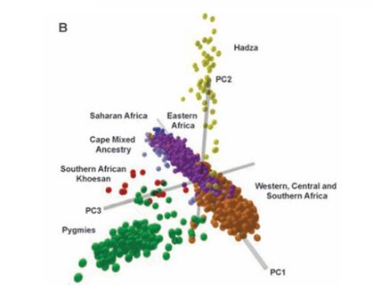
A. Genetic Analyse Pointing the Major Human Populations B. Zoom in the Sub-Saharan Africans race to see the subraces
A

Slide 13
 |  | Quelques caractéristiques…
Phylum | Chordata | With notochord, dorsal marrow.
Class | Mammifère | The young are fed by the mammary glands, skis with hair, body cavity divided into aortic arches, coreless red blood cells, constant body temperature, 3 bones in the middle ear, well developed brain
Order | Primate
Family : | Hominidae | Standing, bipedal locomotion, life based on hands and feet differently specialized, family and social organization.
Genus : | Homo | Big brain, speech, extended life, longer youth.
Species : | Homo sapiens | Important chin, high forehead, thin skull bones, rare hairs.
Main Races/Populations/ Genetic Clusters (synonymous): | 1. Africans 2. Europeans 3. Australian Aborigines 4. Native Americans 5. East Asians (China, Korea, Japan, Singapore) 6. Southeast Asians (Cambandia, Indonesia, Laos) 7. Sout Asians and North Africans (also called MENA for Middle Easterners and North Africans) 8. Arctic People 9. Pacific Islanders | 1. Significant skin pigmentation, frizzy hair, higher hormonal levels (compared to Europeans), earlier puberty (compared to Europeans), menarche and earlier menopause, longer and wider teeth (compared to Europeans), relatively longer arms longer compared to the trunk (compared to Europeans), smaller pelvic diameter... 5. Subcutaneous fat layer (yellowish appearance), hybridization of the eyes (epicanthic fold), shorter arms compared to the trunk, lower hormonal levels (compared to Europeans), later puberty, menarche and later menopause, pelvic diameter more wide (compared to Europeans) ...
Homo Sapiens Taxinomic Classification

Slide 14
-> Homo Sapiens is an animal
There is no more reason to extract Homo Sapiens from the animal kingdom "because on average the smartest " than there would be to bring out the cheetah "because the fastest".
Anecdote recently brought to light: All non-Africans descend in part from Neanderthal.
"An X-linked haplotype of the Neanderthal origin is present among all non-African populations" Molecular Biology and Evolution, July 2011.

Slide 15
Contents
1. The Main Human Populations/Races
2. What’s Intelligence?
3. I.Q Validity
4. Mean IQ Accross the World
5. Intelligence, Highly Genetic
6. Cause of Racial Differences
7. Why Is not the Whole World Developed?
8. The Worldwide Hierarchy
9. Scientific Accreditation
10. Western Twilight and General Conclusion
Notes:
vgrfb

Slide 16
Qualitative Definition of Intelligence
‘Intelligence is a very general mental capability that, among other things, involves the ability to reason, plan, solve problems, think abstractly, comprehend complex ideas, learn quickly and learn from experience. It is not merely book learning, a narrow academic skill, or test-taking smarts. Rather, it reflects a broader and deeper capability for comprehending our surroundings—“catching on,” “making sense” of things, or “figuring out” what to do.’
(Gottfredson, 1997)

Slide 17
Quantitative Definition of Intelligence
Human intelligence is in continuum with animal intelligence (we are animals).
-General intelligence (efficiency of the central nervous system) is higher in great apes (which have the average mental age of 2-3 year old Europeans, 22 average IQ) than in dogs (which have an average IQ of 12).
-Intelligence is higher in a 5-year-old child (IQ of 35) than in the great apes.
-Intelligence is higher in a 10-year-old child (IQ of 70) than in a 5 year-old-child
-Intelligence is more important in adults (average IQ of 100) than in children of 10 years.

Slide 18
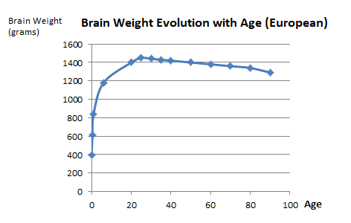
Intelligence increases in childhood with the natural crescendo of the cranial capacity, reaches its maximum around 25 years, concomitantly at the peak of the brain growth, then declines slowly from 30 years and more quickly after 80 years.
"The decline of mental abilities with age is part of a general organic process that constitutes the universal phenomenon of senescence"

Slide 19
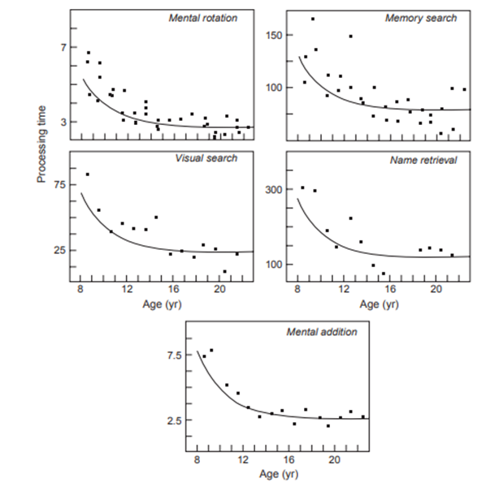
The speed at which information is processed by the brain increases with age until around age 25 (graphs below).

Slide 20
The Metric Scale of Intelligence: IQ
One intelligence ? or many types of intelligence ? Scientists quickly realized that:
-> All cognitive abilities (totally disparate) are positively inter-correlated
-> People who perform well on some tasks tend to perform well on all others
-> All mental faculties are partially determined by a common factor
-> Q.I measures general intelligence = g
-> It is enough to measure some aptitudes to correctly estimate the Q.I general = g = general intelligence
g=IQ (synonymous)
-From « The neurology of human intelligence differences », 2010, Ian J. Deary, Lars Penke and Wendy Johnson, Nature, Volume 11.

Slide 21
g = general intelligence = IQ = general cognitive abilities
The segregation of general intelligence into several types of intelligence (literary, mathematical, artistic, social, musical, economic ...) is more a cultural construction without biological or neurological underbase.
The biological basis of human intelligence is characterized by a large single component, measured by g.
"One of the most remarkable discoveries of all psychology ...
that the scores on all the tests of each variety of mental aptitude are positively inter-correlated for any representative sample of the general population"
-Jensen

Slide 22
" g is to psychology what carbon is to physics"
- C. Brand
" IQ is to sociology what gravity is to physics" - R. Lynn
" IQ is a fundamental characteristic of a society.
We must stop the dysgenic trend in America «
William Shockley, Nobel Prize (Physics).

Slide 23
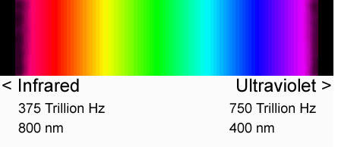
Absolutely all cognitive activities have a certain saturation in g (= IQ correlation)
even the most basic ones (g is ubiquitous of higher cognitive functions). Higher IQ people will perform better on… nearly everything. -Reasoning
-Space visualization
-Memory
-Music
-Languages
-Vocabulary
-Basic cognitive tasks ...
But also for example:
-distinction of colors proportional to g (higher IQ distinguish closer colors tones) simple reaction time to a stimulus…
-Sound distinction aptitude (high Q.I distinguish closer sound tones)
-> All cognitive activities have a certain correlation with the IQ
(= saturation in g, equivalent to the implication of the processor of a computer in a program
-> Some programs are more greedy in speed of processor but all show a proportionality to the clock speed)
See next chapter for a discussion on IQ validity

Slide 24
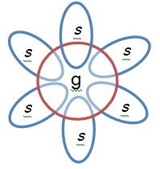
Illustration of the g factor
-> Each specific ability share the general factor g

Slide 25
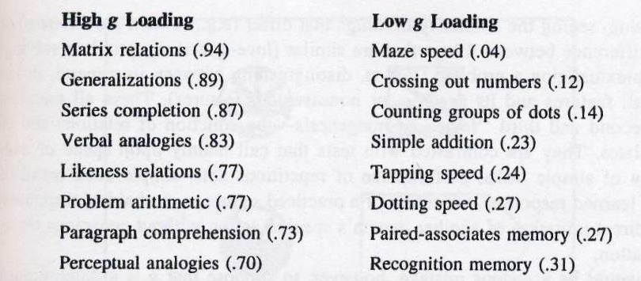
Some Examples of Cognitive Activities and Their g Loading ...
From« The g factor », 1998, A. Jensen.

Slide 26
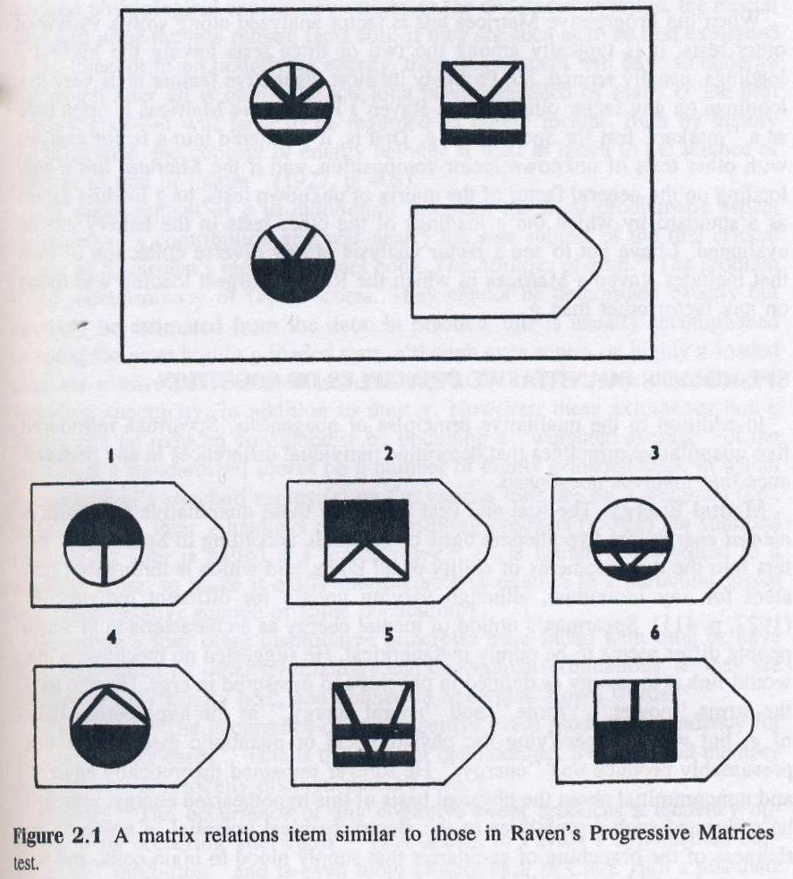
Raven’s Progressive Matrices: one of the highest g-loading at 0.94
(one of the best IQ test because you can correctly extrapolate general intelligence from it)
From« The g factor », 1998, A. Jensen.

Slide 27
g is ubiquitous of higher cognitive functions.
All human activities transiting through the central nervous system show a certain g-loading

Slide 28
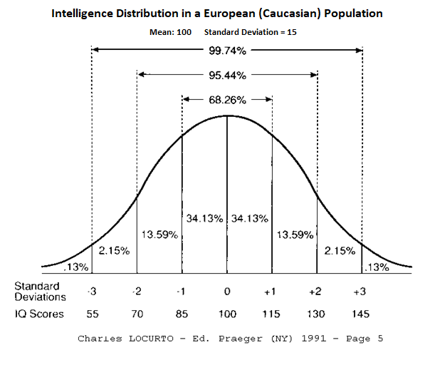
IQ of 100 = g of 100 = mean for Europeans (in America, Europe, Australia…).
Gaussian distribution of intelligence SD=15.

Slide 29
The phenomenon of positive inter-correlations in mental abilities, called "Positive Manifold" has been described as
"probably the most reproduced result of all psychology" (Deary, 2000). -> It is this phenomenon of inter-correlations that allows
the extrapolation, from several tests, of a single figure, IQ, which is not an average of disparate results.

Slide 30
g is not specific to homo sapiens.
It has been possible to extract g factors in dogs, cats, mouses, and primates, meaning that generally an animal intelligent in some kind of taskts will be more prone to be better in others. Non-human primates, as a whole, have a g factor similar to that observed in humans.
https://en.wikipedia.org/wiki/G_factor_in_non-humans

Slide 31
Contents
1. The Main Human Populations/Races
2. What’s Intelligence?
3. I.Q Validity
1. Biological IQ Correlations 2. Social IQ Correlations
Notes:
vgrfb

Slide 32
IQ Validity
Biological IQ Correlates
-Head Size (+0.2)
-Brain size (+0.45)
-Myopia (+0.25)
-Electrochemical activity of the brain
-Cerebral metabolism of glucose
- Nerve conduction velocity * (+0.4)
- brain pH
* Cranial and peripheral nerves

Slide 33
1. Biological Correlates of g (continued)
Auditory Spectrum Finesse (+0.3) (ability to distinguish sounds of nearer frequencies, proportional to IQ).
Visual Spectrum Finesse (+0.3) (ability to distinguish more closely color tones, proportional to IQ)
Visual and Auditory Inspection Time (+0.7) (measurement of the sensory information processing speed)
- Simple reaction time
- Skin color (-0.92) (Evolutionary, see point 6)
Baseline Pupil size
Erythrocyte Sedimentation Rate

Slide 34
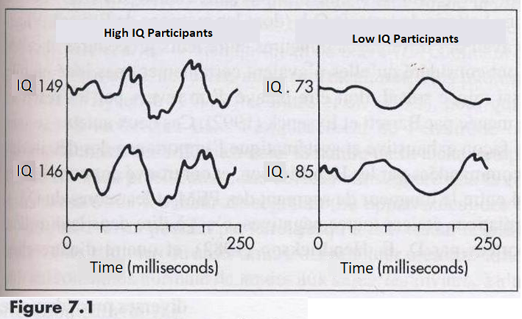
Relationship between IQ and the electrochemical activity of the brain
IQ is correlated: -with the complexity of the waves at the EEG. -with the alpha waves frequency.
From « IQ and Human Intelligence », 1998, Mackintosh.

Slide 35
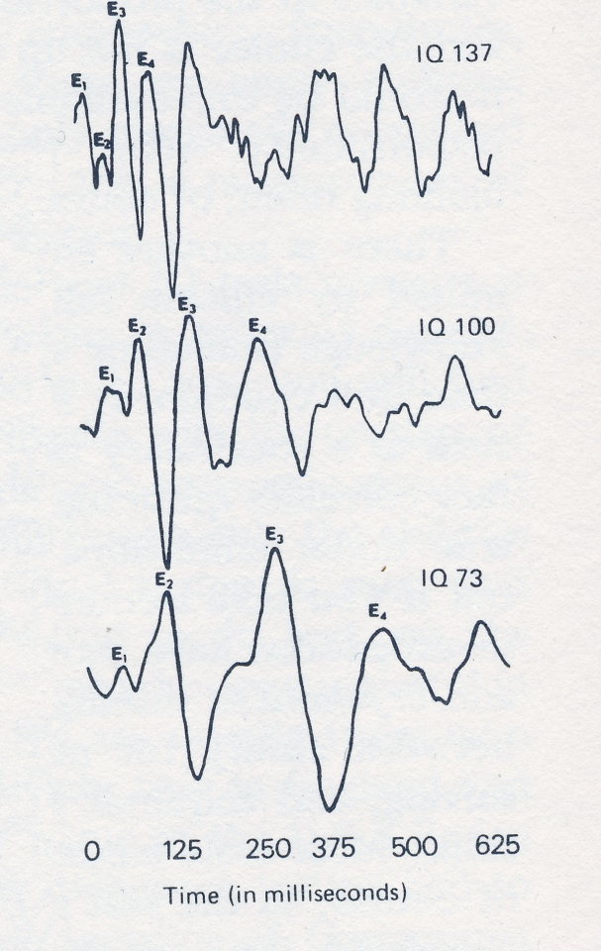
Evoked potentials recorded with EEG. The score used is the length of the first 4 brain waves E1 to E4.
This score is smaller in bright individuals and higher in less intelligent individuals.
In other words: the information transmission is faster in bright people and less in less intelligent individuals.
Tiré de « The I.Q argument: race, intelligence and education », H.Eysenck, 1971.

Slide 36
Cerebral Glucose Metabolic Rate
-> The main brain energy source is glucose.
-> For the same cognitive task, high IQ brains consume less glucose while low IQ brains consume more glucose.
Correlation of -0.7 to -0.8 between IQ and GMR (glucose metabolic rate)
-> For the same task, high IQ brains operate at lower glucose regime while lower IQ brains arrive more quickly
at saturation.
-> Higher IQ brains are more effective.
-> Analogy with a computer:
-a weak computer arrives more quickly to saturation of its processor.
-a more powerful computer is more efficient, it processes identical information using less of its system resources.

Slide 37
If now we subjectively calibrate a difficulty level, for example to succeed a cognitive task in 75% of cases…
With a success rate of 75%:
-Low IQ brains can perform a less complicated task, for example retain 6 digits.
-Higher IQ brains manage to perform a more complicated task, for example holding 8 digits.
In this case, IQ is correlated positively with GMR, mean that higher IQ brains can reach higher maximum glucose metabolic rates, if needed.
-> Analogy with a computer:
-If a less powerfull computer runs at 80 percent of its capacity (threshold subjectively fixed as « difficult task »), it will accomplish a smaller task, achieve a lower processor speed and consume less.
-When a more powerfull computer runs at 80 percent of its capacity (subjectively referred to as a « difficult task »), it will accomplish more difficult tasks because it is able to achieve higher processor speed by consuming more.
-> for the same objective task, higher IQ brains consume less -> more effective brains.
-> for a task judged subjectively difficult, higher IQs perform more complex tasks, are able to reach a higher processing power by metabolizing more glucose (higher GMR) -> They are able to climb higher in their GMR -> more powerful brains

Slide 38
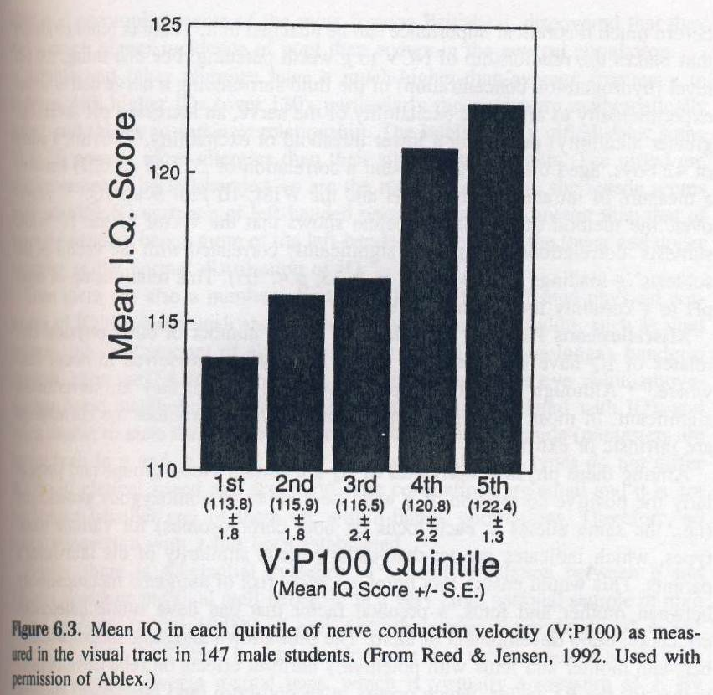
Peripheral and Cranial Nerve Conduction Velocity (+0.4)
From « The g factor », 1998, A. Jensen.
A light is flashing in front of the eyes, a device measures the time it takes for the message
to reach the centers of vision in the back of the brain. This speed is correlated (+0.4) with IQ
-> Better nervous myelination in high IQs

Slide 39
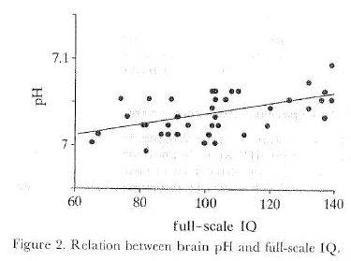
Cerebral pH, a Biochimic IQ Correlate
-> Higher pH increases conduction velocity -> pH variations also modulate the activity of many receptors and neurotransmitters
http://www.vivalis.si/literatura/2a96.pdf

Slide 40
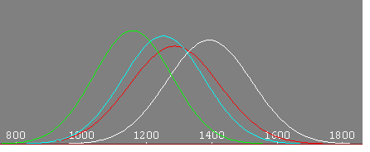
The Brain Size – IQ Correlation is +0,45
Brain size is correlated +0,45 with IQ. The brain size is, like general intelligence (g), distributed in a Gaussian way (bell curve, figure 1 below).
A +0.45 correlation between general intelligence (= IQ) and brain size means that:
1. An increase of 1 SD in brain size (about 120 grams in mass) increases IQ of an average of 0.45 SD (7 IQ points).
2. IQs of 115 (1SD above average) have an average brain size 0.45 SD above average (about 55 grams more in mass).
- Vernon, Wicket, Bazana et Stelmack, 2000.
- « Whole brain size and general mental ability » Int J Neurosci. 2009. - « Brain volume and intelligence: The moderating role of intelligence measurement quality” Intelligence, 2017
Figure 1: Brain size of african americans (red) and europeans (whites)

Slide 41
Among university students, those finishing with distinction show a significantly bigger brain size and those
ending with great distinction have a bigger brain than those finishing with distinction.
General Population < University Students < Distinction < Great Distinction

Slide 42
2. Some Social IQ Correlates
- National/Racial IQs Predict Success in Math and Science
- IQ Predicts Salary
- IQ Predicts Education Level
- IQ Predicts Socioeconomic Status
- IQ Predicts Trainability
- IQ Predicts Job Proficiency
- IQ and Violent Behavior
- National/Racial IQ Predict PISA Scores
- IQ at 13 Predicts of Many Subsequent Achievements
- National IQ, Predictive of GDP/Capita from 1500 to 2000
- National IQ, Predictive of Life Expectancy
- National IQ, Highly Predictive of Index of Human Development

Slide 43
From Murray and Hernstein, Harvard Professor, « The bell curve », 1994.

Slide 44
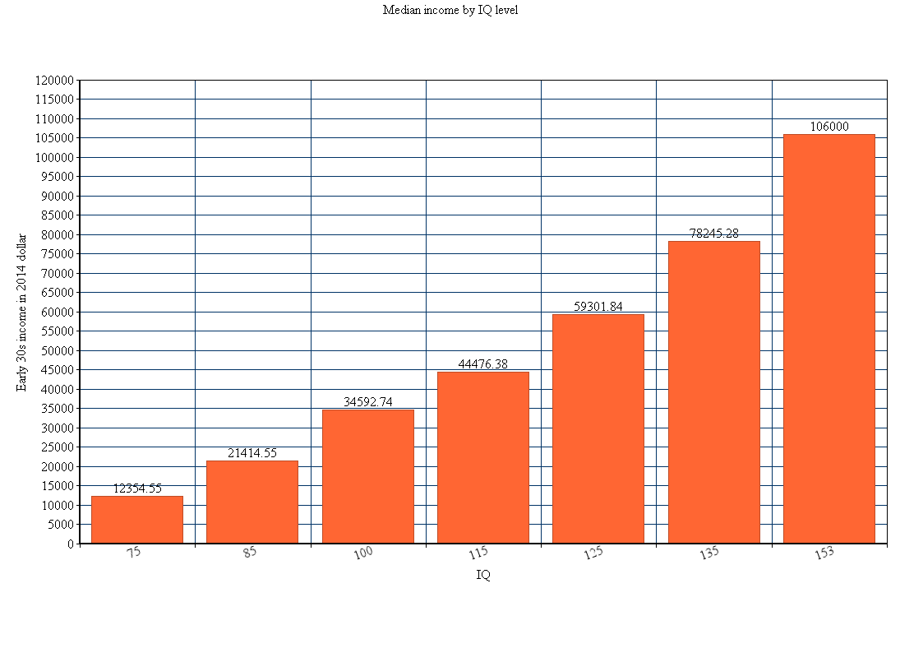
Increasing Median Income by IQ level (1993 data)

Slide 45
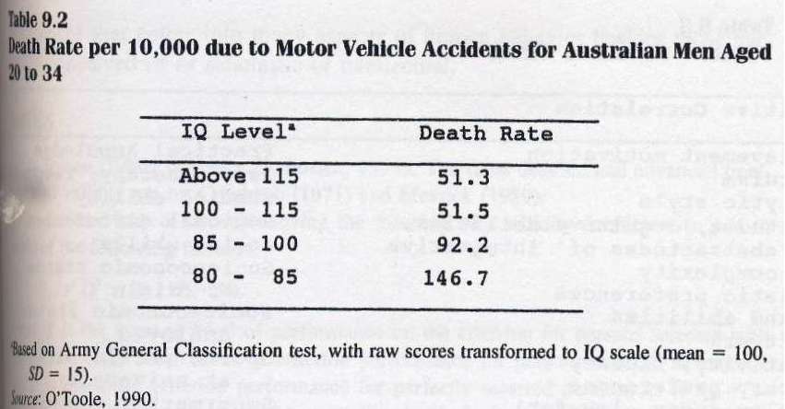
On The Road…
From « The g factor », 1998, A. R. Jensen.

Slide 46
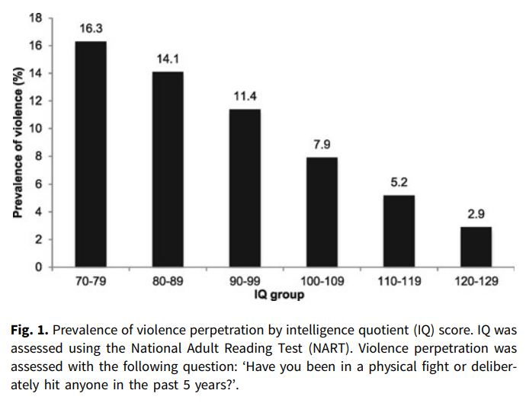
Lower IQ is linearly associated with higher violence in the general population.
“Association between intelligence quotient and violence perpetration in the English general population” Cambridge University Press, 2018.

Slide 47
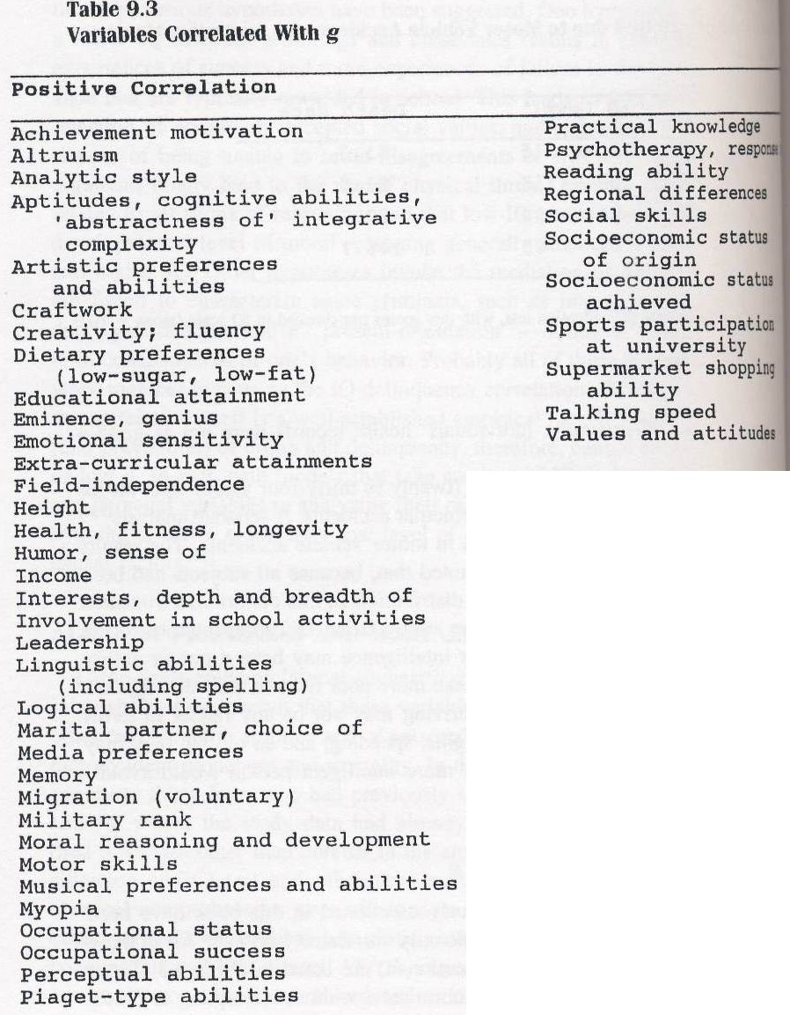
From « The g factor », 1998, A. R. Jensen.

Slide 48
“Genius” requires an extremely high g level (IQ).
Mean IQs of Historical Geniuses, Estimated by Catherine Cox
Category | Mean IQ
Scientist Soldiers Statestnen Writers Artist Musicians Philosophers Religions leaders | 155 132 162 164 150 164 175 160
From « Eugenics, a reassessment », 2001, Richard Lynn.
Scientific Nobel Prize: Average IQ of 158 (4SD, measured) ie ~ 1/20000 (potentially 50 individuals per million in European populations)
-> A very high IQ is needed -> Bigger average brain size of 4x0.45 = 1.8SD> overall average, ie 1.8 x 120 = 216 grams > average (1369 cc versus 1585 cc for a population with an average IQ of 158)
-> Obvious biological basis of genius

Slide 49
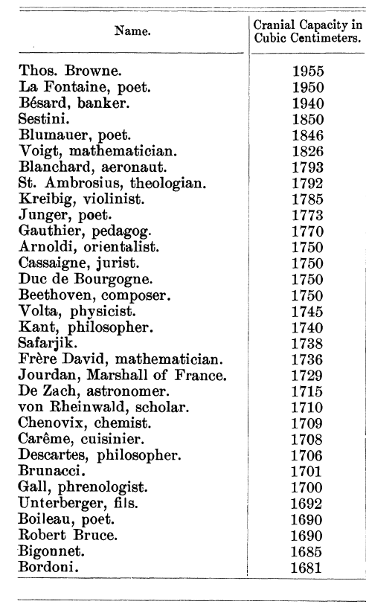
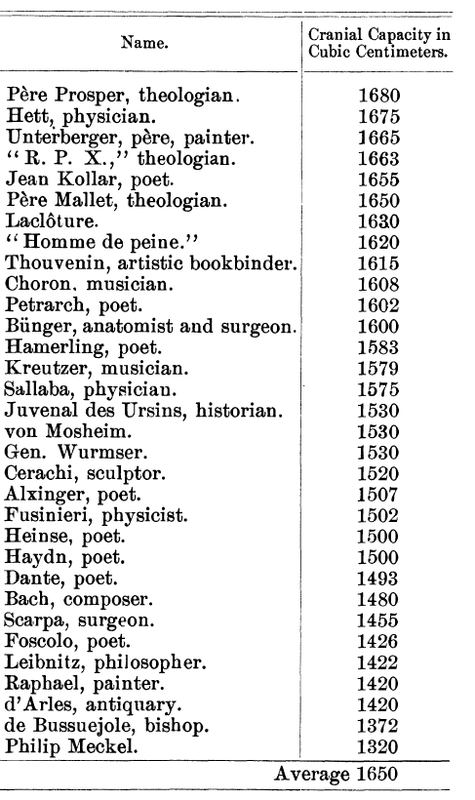
Anecdotally, the estimate of “a bigger brain by 216 grams" for a population of European homo sapiens with an IQ of 160 is very close to the difference of 240 cc actually found in a brain study of 65 eminent men ...

Slide 50
It should be noted that highly intelligent individuals with below average brain size can
be found (Smetana, Anatole France…) the correlation is not 1 but only +0,45
-> Let’s Imagine a safe filled with jewelry and bank notes of 5-10-20-50-100-200-500 euros.
-> Blindly, you take with the help of a small shovel of say 1200ml full content from this safe. You repeat the operation 10 times.
-> With the help of a larger 1400ml shovel, you blindly perform 10 shots in the safe too.
What do you notice?
On average, the value of an intake of 1400ml is greater than that of 1200ml.
This is not true in all cases: it is possible for a 1200 ml take to be very valuable, simply because it is very dense in 500 eurs notes and jewels, for example. Conversely a catch of 1400ml can be of little value because more dense in notes of 5 and 10 euros.

Slide 51
Contents
1. The Main Human Populations/Races
2. What’s Intelligence?
3. I.Q Validity
4. Mean IQ Accross the World
5. Intelligence, Highly Genetic
6. Cause of Racial Differences
7. Why Is not the Whole World Developed?
8. The Worldwide Hierarchy
9. Scientific Accreditation
10. Western Twilight and General Conclusion
Notes:
vgrfb

Slide 52
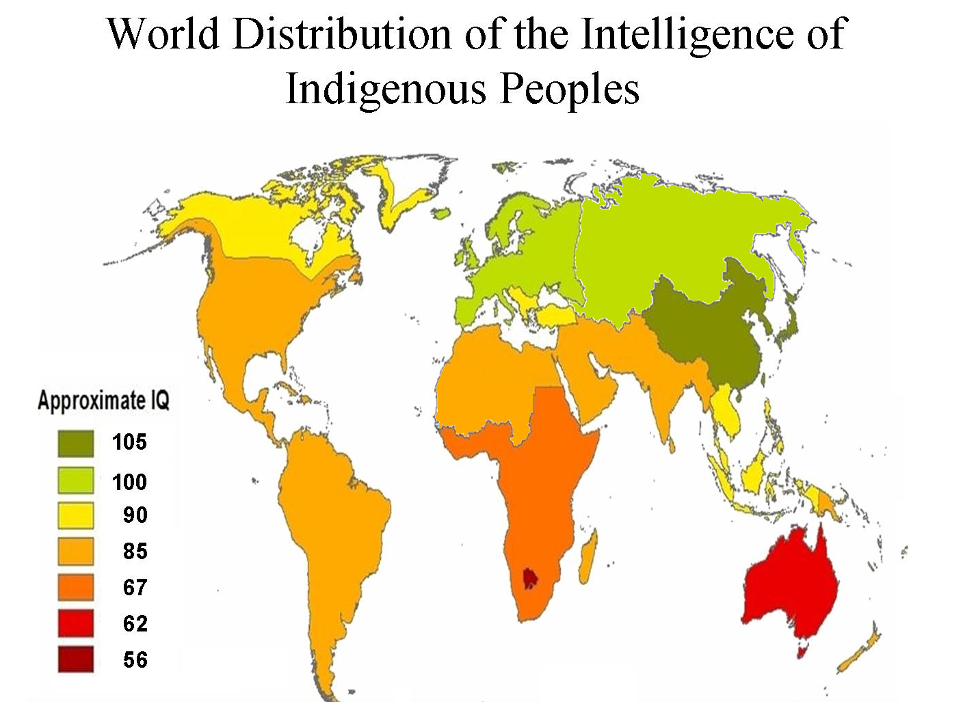
Mean g = Mean IQ of Indigenous Populations (America for Native Americans, Australia for Australian Aborigines)
Meta-analyse, 620 collected studies on 813,000 people, see « race differences in intelligence, 2006, Lynn. Even more studies in the 2nd edition, 2015.

Slide 53
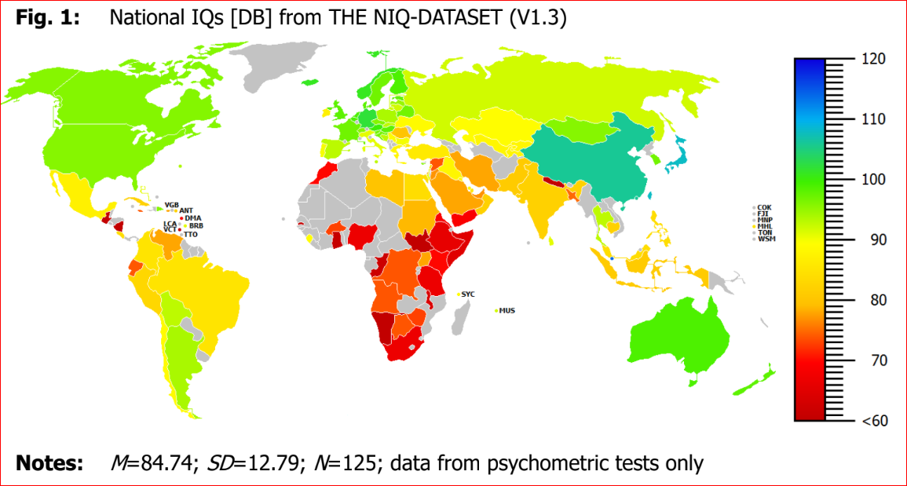
David Baker (2018) get quite the same results than Lynn…

Slide 54
-> In sub-Saharan Africa ... average IQ = 71. An IQ of 100 corresponds to the cognitive abilities of a 16 year old European.
-> Sub-Saharan Africa: Average IQ ~ 70. (borderline, mental retardation threshold according to European standards)
A better way of seeing things: IQ of 70 = Mental age of a 11 years European (compared to a European of 16 years). An 11-year-old is not "mentally retarded",
he can do a lot of things: working in a factory, doing supervision ...

Slide 55
-> Conversely, mean IQ of East Asians is 105 (China, Japan, Korea, Singapore...) slightly higher than that of Europeans -> Only 37% of European have an higher I.Q than 50% of East Asians
IQ tests critics generally avoid to consider this particular point ...
-> African Americans have an average IQ of 85, intermediate between that of Africans in sub-Saharan Africa and that of Europeans. (Afro-Americans have an average of 25% European ancestry, pure black Americans in the south states have an average IQ of 78-80, see below)

Slide 56
General Summery on Race Differences in Intelligence
Whatever the country around the world :
1. Ashkenazy Jews (110) (America, Europe, Africa)
2. East Asians (105) (Asia, Europe, America…)
3. European (100) (Australia, America, Europe…)
4. Arctic People (91)
5. European-African Hybrids(90) (Europe, America…)
6. Southeast Asians (90) (Europe, America, Asia)
7. Native Americans (87) (North and South America)
8. North Africans and South Asians (86) (Middle East, America, Europe…)
9. Africans (80) (Europe, North and South Amrica, Africa…)
10. Aborigènes d’Australie (62)

Slide 57
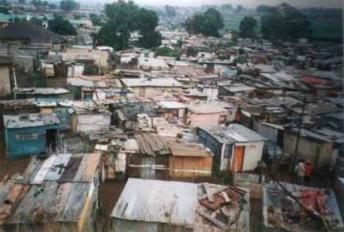
Sub-Saharan Afria, Mean IQ 71 Nature or Nurture ?
Bad environment -> Low IQ?
Or low IQ -> Bad environement?
is responsible for
is responsible for

Slide 58
Contents
1. The Main Human Populations/Races
2. What’s Intelligence?
3. I.Q Validity
4. Mean IQ Accross the World
5. Intelligence, Highly Genetic
Notes:
vgrfb

Slide 59
1. Intelligence is Highly Genetic
-> Heritability of the intelligence = part of the variance attributable to genetic factors. There are 3 ways of estimating it, pointing to a whole heritability > 0.8 in adulthood.
This means that if everyone was raised in an identical environment, intellectual differences between individuals would be reduced to 80% of the current differences (remaining quite large)
1st Method: Studies of homozygot twins raised in different environments (Data summarized by Bouchard, 1993). In adults, the weighted average correlation for sample size is 0.75. This figure must be corrected for the reliability of the tests (correction of the attenuation, Bouchard, 1993, p.49, Machintosh, 1998). This correction increases the correlation to a real value of 0.83.

Slide 60
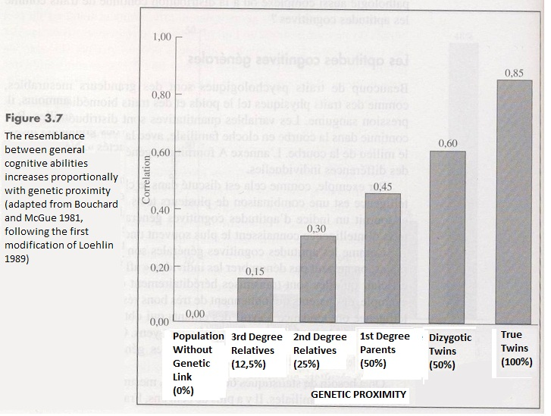
« Behavior Genetics », 2013, Plomin, de Fries, Mc Clearn, Rutter.

Slide 61
The high level of heritability found in identical twins in America, Europe, Japan and India
shows that intelligence is strongly determined by genetic factors.
From « L’esprit nu », Hans et Michael Eysenck, 1981.

Slide 62
2nd method to estimate heritability of intelligence: to compare the degree of similarity between identical twins and non-identical twins, of the same sex, raised in the same family. The correlation is 0.88 for identical twins and 0.51 for non-identical twins of the same sex. After correcting these figures for the reliability of the tests (correction of attenuation), the corrected correlation becomes 0.98 for the identical twins and 0.56 for the non-identical twins. Heritability can be calculated by Falconer's (1960) formula of doubling the difference between the correlations of identical and non-identical twins of the same sex. The difference between the two correlations is 0.42, doubling this difference gives a heritability of 0.84 -> Estimate almost identical to the first one.
Heritability of a trait (Falconer’s formula) = ( (correlation identical)-(correlation non identical) )x2
= 0,42x2 = 0,84

Slide 63
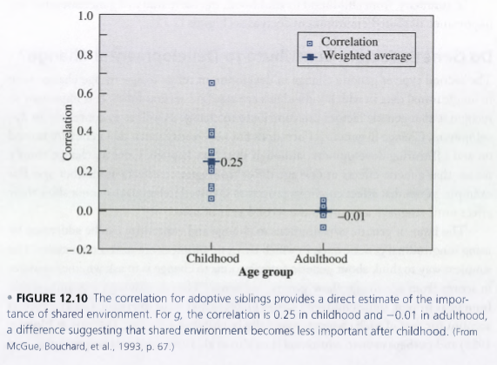
3rd Method to Estimate Heritability: Examine the IQ correlation between children of different biological parents adopted and raised in the same families. In this way we can estimate family environment effect. In adults the correlation is between -0.01 and 0.04 indicating an heritability of at least 0.96. However, this method underestimates the environmental effects because it does not take into account the prenatal and perinatal environment (-> but precisely, this method makes it possible to know the environmental elements with or without an effect!)
« Behavior Genetics », 2013, Plomin, de Fries, Mc Clearn, Rutter.

Slide 64
-> The first two methods are more precise and give an estimate of 0.83 and 0.84 for the heritability of intelligence. The conclusion of a high heritability for intelligence implies that there are genes that determine intelligence. The first was discovered by Chorley et al. (1998). It is located on chromosome 6 and the possession of one of the allles of this gene contributes up to 4 points Q.I. Today thousands of intelligence genes have been discovered (responsible for a gain or decrease of a tiny part in IQ score, usually <1 point). It is now possible to predict intelligence by a genetic analyse.
“Genome-wide association meta-analysis in 269,867 individuals identifies new genetic and functional links to intelligence” Nature, 2018.

Slide 65
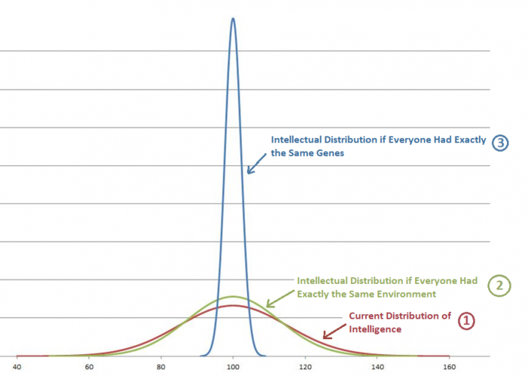
Illustration of The Genetic Part and The “Environmental" Part of Intelligence

Slide 66
2. Great stability of mean IQ of the different races whatever the environment, whatever the country -> supports the genetic causality (see Worldwide Hierarchy after) Slight increase in better environment (84 to 88 for Arabs in Europe for exemple ...) but genes "keep the improvement on a leash". East Asians in Europe or America: 105.
« The Global Bell Curve », 2009, Lynn.

Slide 67
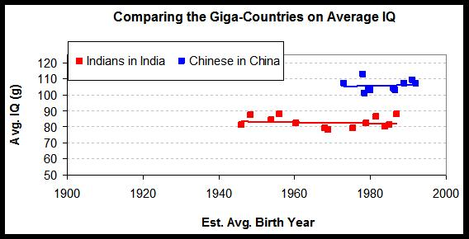
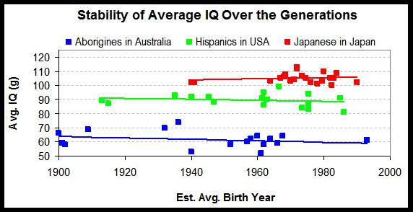
3. Stability over time

Slide 68
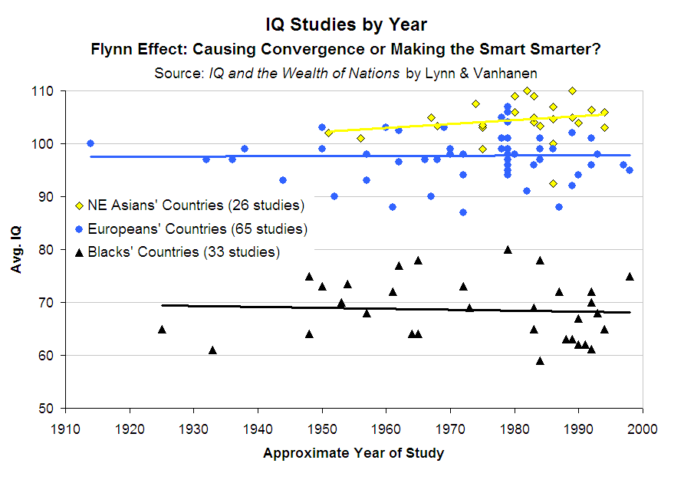

Slide 69
The racial IQs are remarkably stable over time. So for example, IQs of Africans have shown no change since the first study published by Fick (1929) pointing an average IQ of 65 for Africans in South Africa. The 4 most recent studies on African intelligence in South Africa find virtually identical IQs of 69 (Nell, 2000), 68 (Sonke, 2000), 67 and 64 (Skuy et al., 2001).

Slide 70
4. IQs Differences Are Reflected in the Differences in Brain Size.
Table 9.8. Race differences in brain site (cc) and intelligence
Race | IQ | Brain Size (cc)
East Asians | 105 | 1416
Europeans | 100 | 1369
Southeast Asians | 90 | 1332
Pacific Islanders | 85 | 1317
South Asians and north africans | 84 | 1293
Africans | 67 | 1282
Australian aborigenes | 62 | 1225
These differences in brain size demonstrate the existence of genetic factors,
because the cranial volumes’ heritability is 0.9 and correlation between intelligence
and brain size is 0.45.
« Race Differences in Intelligence », Richard Lynn, 2006 and 2nd edition 2015.
« The Limits of Democratization », Tatu Vanhanen, 2009, université of Tampere, Finlande. « Le quotient intellectuel, ses déterminants et son avenir » Serge Larivée, Montreal University, 2009.

Slide 71
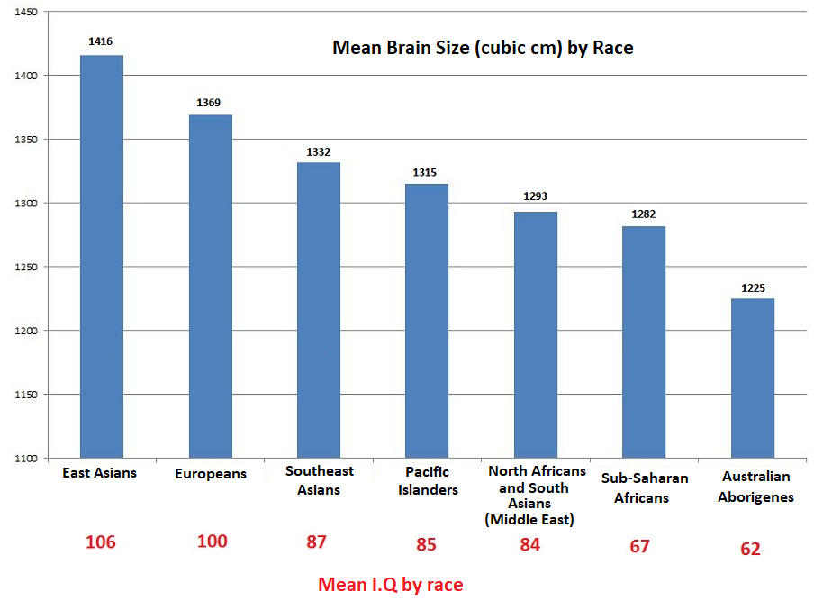
« Race Differences in Intelligence », Richard Lynn, 2006 and 2nd edition 2015.
« The Limits of Democratization », Tatu Vanhanen, 2009, université of Tampere, Finlande. « Le quotient intellectuel, ses déterminants et son avenir » Serge Larivée, Montreal University, 2009.

Slide 72
« The g factor », A. Jensen, 1998.

Slide 73
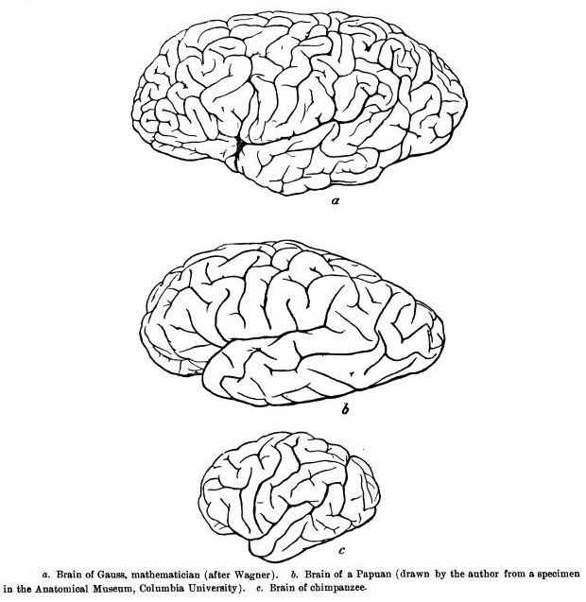
Gauss’ Brain (IQ 180)
Anecdotally, comparison of the brain of Gauss (mathematician), an Australian aborigine and a chimpanzee.
Brain of an Australian Aborigine
Brain of a chimpanzee, IQ 22

Slide 74
5. Studies on Racial Hybrids
IQs of « hybrids » is always intermediate between that of the two parental races, as well as the cranial volume, also intermediate between that of the two parental races -> Clear genetic causality (polygenic)
Table 4.12. IQs of Europeans, African-European hybrids, and Africans
 |  |  |  | European |  | Hybrids |  | Africans
 | Location | Age | Test | N | IQ | N | IQ | N | IQ | Reference
1 | Brazil | 10 | SPM | 735 | 95 | 718 | 81 | 223 | 71 | Fernandez, 2001
2 | Germany | 5-13 | WISC | 1,099 | 100 | 170 | 94 | - | - | Eyferth, 1961
3 | South Africa | 10-12 | AAB | 10,000 | 100 | 6,196 | 83 | 293 | 65 | Fick, 1929
4 | South Africa | 13 | GSAT | 746 | 100 | 815 | 86 | - | - | Claassen, 1990
5 | South Africa | 15 | SPM | 1,056 | 100 | 778 | 80 | 1,093 | 74 | Owen, 1992
6 | USA | 17 | WISC- R | 16 | 102 | 55 | 94 | 17 | 85 | Weinberg et al., 1992
7 | USA | Adult | Otis | - | 100 | 284 | 91 | 176 | 87 | Codwell, 1947
8 | USA | Adult | Vocab | 1,245 | 100 | 304 | 92 | 146 | 85 | Lynn, 2002
9 | USA | Adult | Vocab | 10,315 | 100 | 116 | 97 | 4,271 | 89 | Rowe, 2002
But also ... aboriginal-European or Asian-European hybrids ... http://www.human-intelligence.org/intelligence-is-genetic/#genetic6

Slide 75
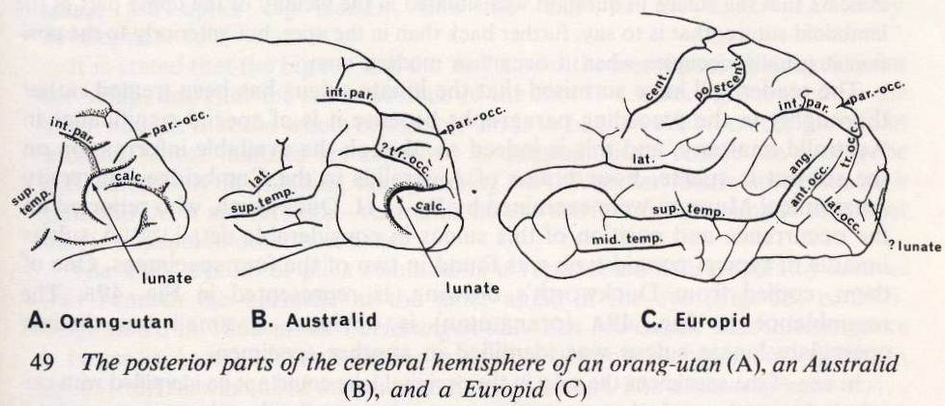
6. Qualitative Racial Differences
Races don’t only differ in brain size, there are qualitative racial differences.
Africans and Europeans
-Africans’ cortex is on average less convoluted. -Africans have a smaller frontal and occipital lobe and larger ventricule (cavities filled with cerebrospinal fluid)
Australian Aborigines and Europeans
From « Race », John R. Baker, Oxford biology professor, 3rd edition 2012

Slide 76
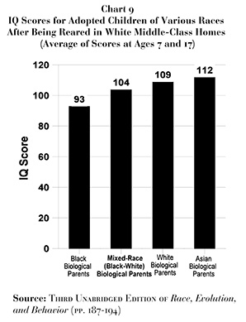
Clearly show that the IQs remains fully predicted by the biological race regardless
of the adoptive parents.
Koreans adopted by Belgians: IQ of 106 in adulthood. African-americans adopted by Europeans: 85
-> Genetic factors.
-> For children who are all adopted by
European middle-class parents, there is a
difference of 16 IQ points between African-
Americans and European, exactly the same as that found in America.
-> Raising black children in a middle-class white family has no effect on their IQ at 17 years.
-> Education has no more effect on East-Asians adopted by European, their average IQ
remains higher than that of Europeans.

Slide 77
8. Reaction Time
There is a significant difference between Europeans, Africans and East Asians in terms of reaction time.
The reaction time is correlated with IQ, as both are signs of efficiency of the central nervous system. Europeans react on average faster to a stimulus than Africans but less quickly than East Asian
(simple reaction time, row 2)
Table 4.10. Reaction Limes and EEGs of Africans and Europeans
 | Test | Africans | Europeans | East asians
1 | IQ | 68 | 100 | 106
2 | RT-S | 398 | 371 | 348
3 | RT-C | 1,950 | 1,220 | -
4 | EEG | 534 | 506 | -

Slide 78
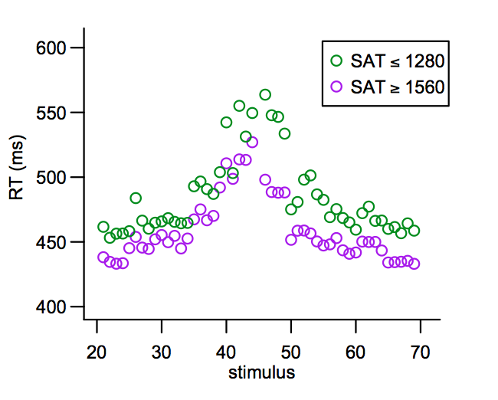
Meilleure efficience du système nerveux central des hauts Q.I
(IQ < 130)
(IQ > 160)
Reaction times are measured as follows: Someone is placed in front of a small lamp that will light. Whenever he does, he simply presses the button in front of him as quickly as possible. This operation is repeated to get a mean Reaction Time. This “Reaction Time” is a sign of the efficiency of the nervous system since it is a basic treatment of information. Reaction times are measured in milliseconds.

Slide 79
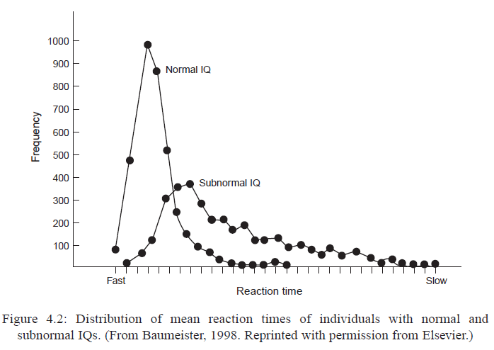
From « clocking the mind: mental chronometry and individual differences, Jensen, 2006.

Slide 80
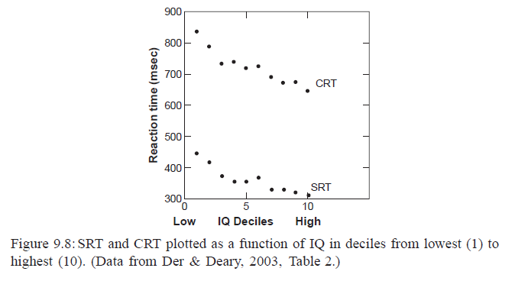
Reaction Time by IQ Decile
Reaction Time decrease linearly as IQ increases
From « clocking the mind: mental chronometry and individual differences, Jensen, 2006.

Slide 81
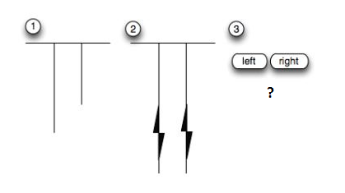
9. « Inspection Time »
"Inspection time" measures the speed of processing visual or auditory information. “Inspection Time" measures are correlated +0.7 with IQ.
In this type of test, two bars of unequal length appear on the screen for a short period of time (in milliseconds). The person tested is then asked which was the longest bar, the one on the right or the one on the left?
High IQs process visual or auditory information more quickly. They have smaller inspection times.

Slide 82
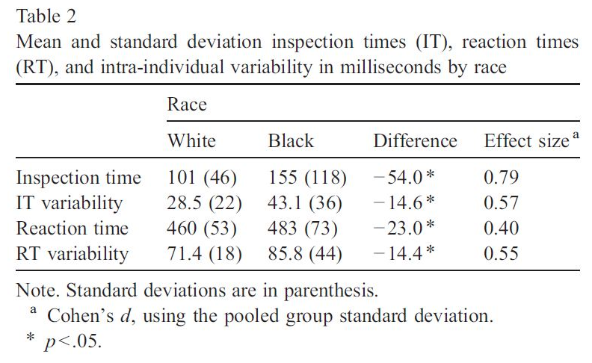
There Are Significant Race Differences in Inspection Time

Slide 83
10. European admixture among African-Americans.
-> The more the European admixture, the higher the average brain weight, the higher the IQ.
Average IQ of pure Africans in US (South States): 80
With 25 percent of European descent: 85 (mean for African-Americans)
Mean IQ for European-African hybrids: 90
Mean IQ with 75 percent European descent: 95
Correlation of -0.91 between skin pigmentation and IQ (Larivée, 2009; Templer, 2006)

Slide 84
11. 76 musculoskeletal features
Racial differences in brain size are correlated with 76 musculoskeletal traits identified in standard evolutionary books as consistently related with an increase in brain size and intelligence in hominids
Among these differences, we find:
The pelvis transverse diameter: Increase in brain size and intelligence has been paired with an increase in the pelvis transverse diameter, to allow the passage of the skull at birth. Africans have a significantly smaller pelvic diameter than Europeans. (27.4 cm against 24.6 for Africans). East Asians have a greater pelvic diameter than Europeans.
As a consequence of a larger pelvis, the femur (the thigh bone) which is inserted at the level of the pelvis curved, since in spite of a growing pelvis, spacing the femoral insertions and causing a wider angle for the exit of the two femurs, it was imperative that the knee makes a proper junction with the fibula, causing a curve of the femur. Europeans have a significantly greater femoral curvature than Africans and significantly less than East Asian.
While intelligence and cranial capacity have increased, skulls have become more spherical and deep. Europeans have significantly more spherical brains, deeper and bigger than Africans.
The increase in sphericity has therefore reduced the protuberances, in particular the mastoid process. Whites have a significantly smaller mastoid process than blacks.
Increase in cranial capacity occurred towards the front of the skull, resulting in a decrease in prognathism and an increase in orthognathism (flatter face). Europeans have a significantly less prognathic and more orthognathic face than Africans.
Very informative: "Progressive Changes in Brain Size and Musculoskeletal Traits in Seven Hominoid Populations", Rushton, Human evolution, Vol. 19 (173-196) 2004. http://www.human-intelligence.org/wp-content/uploads/2019/03/progressive-change.pdf

Slide 85
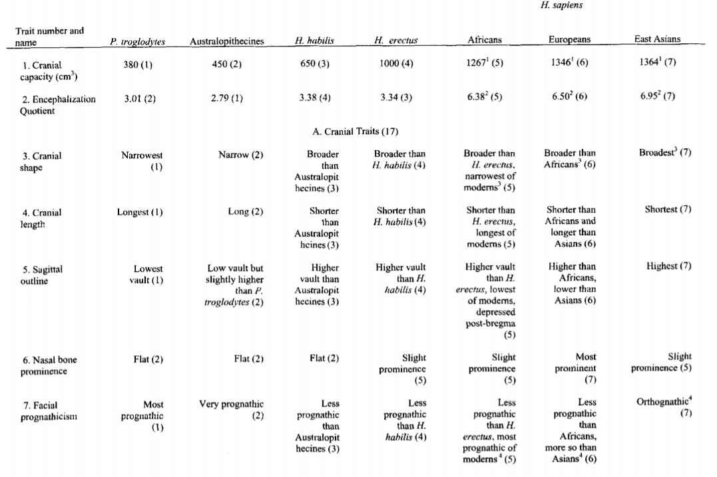
"Progressive Changes in Brain Size and Musculoskeletal Traits in Seven Hominoid Populations",
Human evolution, Vol. 19 (173-196) 2004.

Slide 86
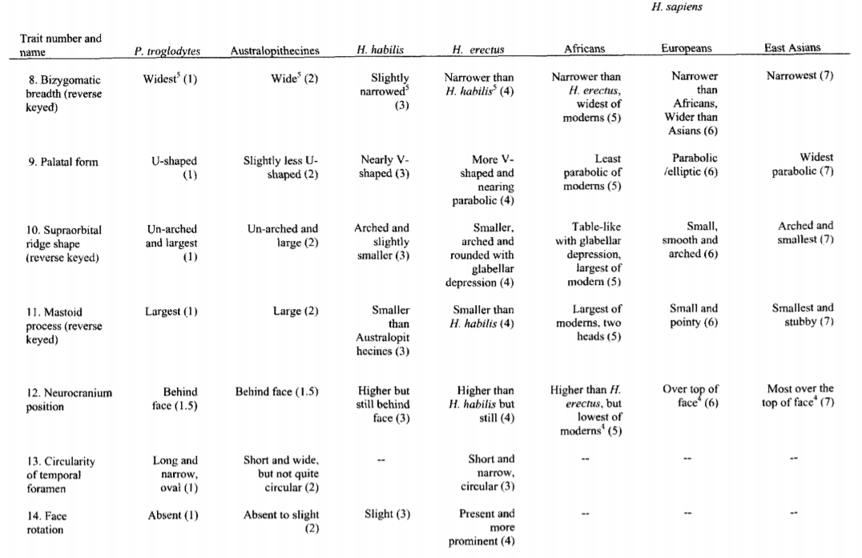
"Progressive Changes in Brain Size and Musculoskeletal Traits in Seven Hominoid Populations",
Human evolution, Vol. 19 (173-196) 2004.

Slide 87
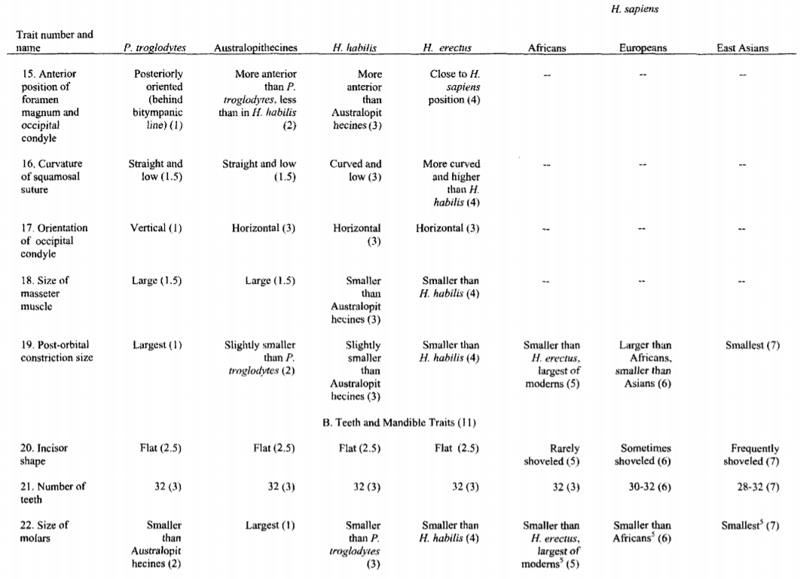

Slide 88
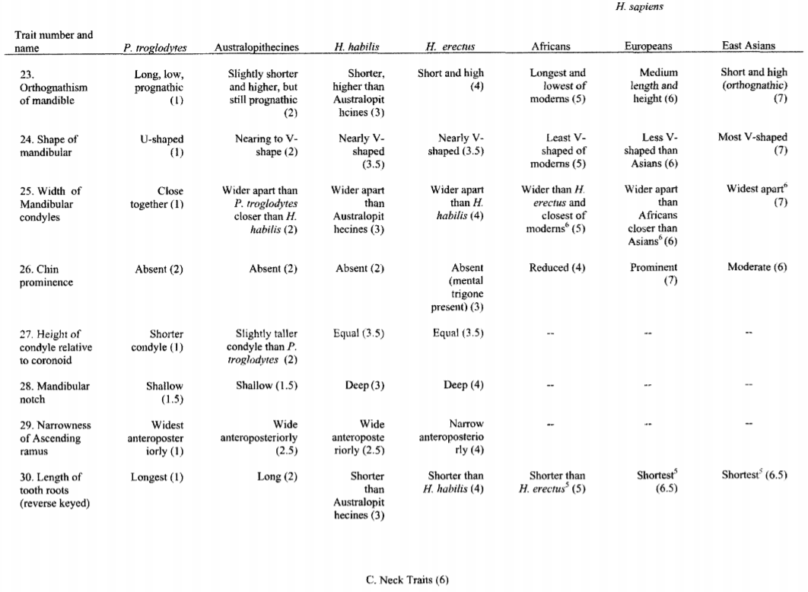

Slide 89
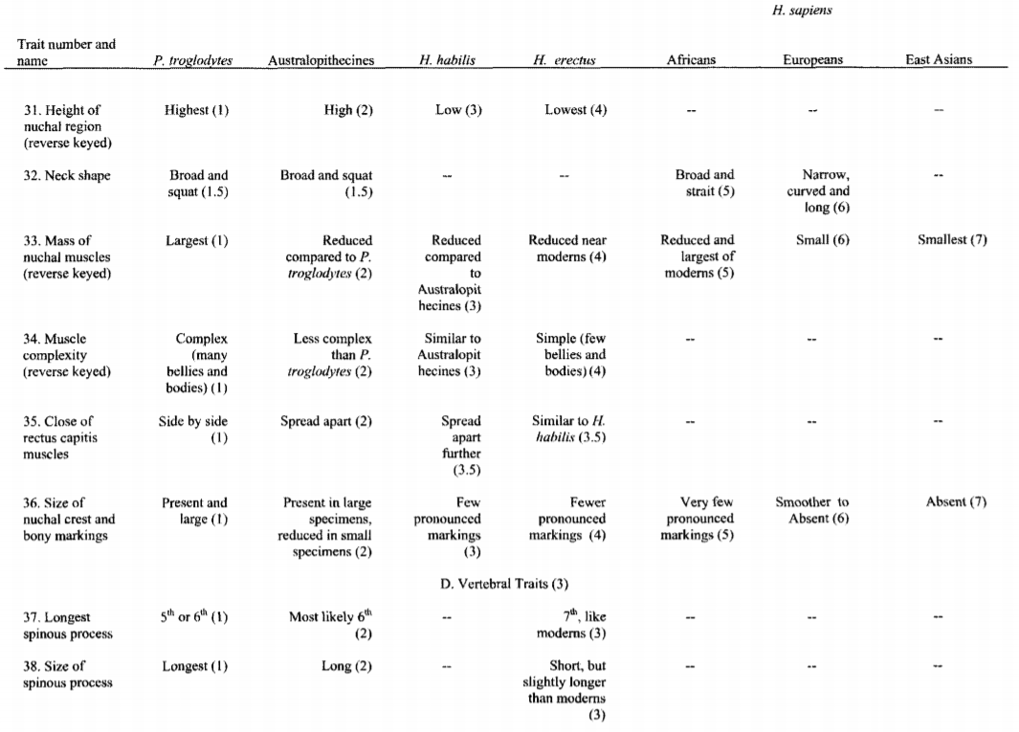

Slide 90
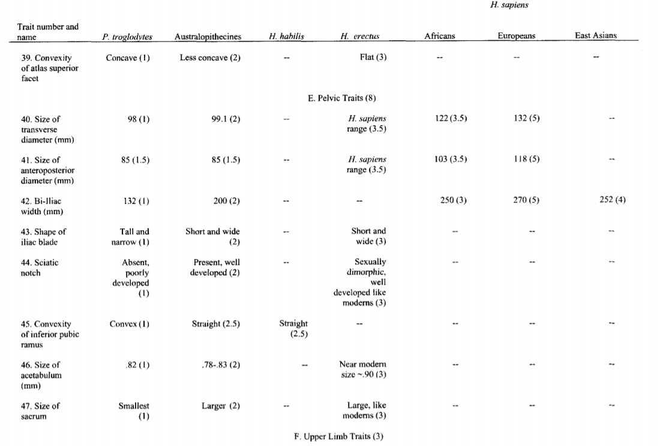

Slide 91
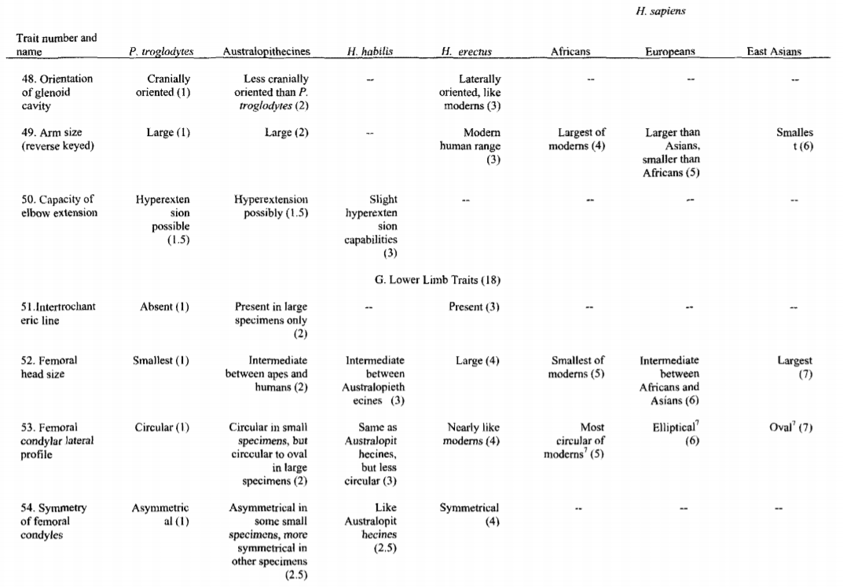

Slide 92
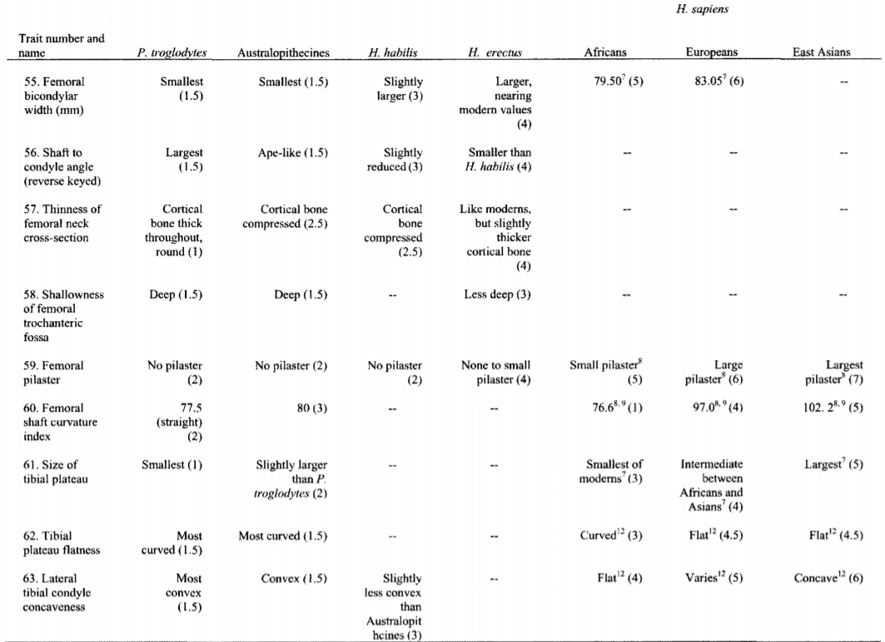

Slide 96
Many egalitarians have suggested that white racism
can reduce black IQ, but there is no explanation for
how racism could diminish IQ and why in this case
IQ of Africans in Africa, measure by african examiners,
Is 71?
If racism diminishes intelligence, it is curious that
Ashkenazy Jews in America and England have an average IQ of 110, while they have been exposed to racism for centuries. The high Q.I of American Jews is well known since the 1930s.

Slide 97
12. Regression to The Mean
Regression to the Mean for Stature
Regression to the mean for Intelligence,
Europeans regress to 100,
Afro-Americans to 85.
-> Signature of the genetic cause of Intelligence
-> Additive genetic model

Slide 98
How to Understand Regression to The Mean ?
-> Imagine two beans of the same size: bean A and bean B, let’s say of 2 cm. Bean A come from a breed (= variety) of big beans (let’s say 3 cm) Bean B comes from a breed of small beans (let’s say 1 cm) The seeds of bean A and bean B are planted. What is observed in the offspring? The offspring of bean A will grow towards their higher “racial” mean in size: the offsprings’ beans will be larger than 2 cm.
The offspring of bean B will regrow towards the racial average of B, namely a smaller size. The offsprings’ bean of B will be smaller than 2 cm.

Slide 99
Regression to the mean occurs for all polygenic traits, like IQ. Take two couples having an average IQ of 110, an African couple and a European couple. The children of the European couple will show an IQ reduction towards the European
IQ average of 100: they will have on average IQ of 105.
The children of the African couple will go back to the African intellectual average of 80:
they will have an average IQ of 95.
This phenomenon of regression to the mean is also noticeable among low IQs:
Children of European couples having an average IQ of 75 will have a mean IQ of 87.5
(regression to the average of 100), whereas children of African couples with
an average IQ of 75 will have an average IQ of 77,5 (regression to the average of 80).
-> Signature of the European average IQ at 100 and of the average African at 80 (polygenic)
-> It’s the reason why black children from wealthy black couples are more likely to backslide into a lower economic group. https://www.theatlantic.com/business/archive/2015/01/how-black-middle-class-kids-become-black-lower-class-adults/384613/

Slide 100
13. Heritability Increases with Age
-> This points to the genetic causality of intelligence.
If environment had an impact, its importance should increase with age, but it's the opposite
that happens. The unshared environment is essentially in utero environment.

Slide 101
14. Racial Differences in the EEG.
As explained earlier, evoked potential of smarter individuals have a smaller "score": alpha waves frequency is greater.
In other words, the information transmission is faster in higher IQ people. There is a significant difference, in terms of EEG score, between races.
Table 4.10. EEGs of Africans and Europeans
 | Test | Africans in Africa | Europeans in Europe
1 | IQ | 68 | 105
2 | EEG | 534 | 506
Table from Sonk (2000)

Slide 102
15. Racial Differences in Intellectual Maturation Speed
→ (1) Fastest intellectual development among Australian Aborigines and the lowest final intelligence (average IQ 62)
→ (2) Intellectual development among Africans a little slower than among Aborigines and slightly higher final intelligence (average IQ 71)
→ (3) Slower intellectual development among Europeans and higher final intelligence (average IQ 100)
→ (4) Least fast intellectual development and highest final intelligence among East Asians (average IQ 105)

Slide 103
→ It is a well-known principle of evolutionary biology that the more developed species, reaching higher intelligence in adulthood, have a longer period of maternal dependence.
As soon as the baby reptiles hatch their eggs for example, they can move and fend for themselves.
Monkeys have a few years of maternal dependence. Among the primates, the most primitive are the lemurs, who have 2 years of maternal dependence; macaques have 4 years of maternal dependence but reach a higher intelligence than lemurs in adulthood; chimpanzees are even more developed and require about 8 years of maternal dependence; and homo sapiens is the most developed and has about 14 years of maternal dependence. This principle extends to the 3 main homo sapiens races: East Asian have a slower development, a longer period of maternal dependence and the highest final intelligence; Europeans mature faster while sub-Saharan Africans grow fastest, have the shortest period of maternal dependence, and the lowest final intelligence. These differences are present in physical, motor and mental development. Regarding physical development, Africans have higher skeletal maturity at birth, faster dental development in childhood, and faster sexual development with earlier adolescence (measured by breast appearance in girls and by genital development in boys).

Slide 105
16. Intelligence Is Part of a Set of Evolutionary Traits
→ East Asians and Africans are at both ends of a continuum with Europeans in an intermediate position, not only on the average scores of cognitive tests and brain size, but also on 60 variables including maturation rate, personality, reproduction and social organization (table below).
This shows that intelligence is part of a larger, evolutionary process originating in evolution.

Slide 107
17. Existence of Racial Differences in Intelligence For 10,000 years
The contemporary race differences in IQ, and between nations, can be identified 10 thousand years ago already from the differences in terms of:
-cranial capacity
-in the ability to make the Neolithic transition from hunting and gathering to secular agriculture 8000 years ago
-in the development of the first civilizations 6,000 years ago
-in the scientific, mathematical and technological advances of the past 2,500 years
“Consistency of race differences in intelligence over millennia”, Richard Lynn, Personality and Individual Differences 48 (2010) 100–101. http://xa.yimg.com/kq/groups/1292538/237290356/name/Lynn+(2010

Slide 108
From Lynn R., « IQ’s predict differences in the technological development of nations from 1000 BC through 2000 AD », Intelligence (2012), doi:10.1016/j.intell.2012.05.008 http://static.wikeo.be/files/7655/1-s20-s0160289612000748-main.pdf?download

Slide 109
18. Inbreeding Depression
Reduced biological fitness in a given population as a result of inbreeding, or breeding of related individuals.
IQ deficit of 7 IQ points in the offspring of first-generation cousin crosses
-> Point the genetic causality of intelligence.

Slide 110
19. Spearman’s hypothesis
The magnitude of the intellectual difference between two races, observed in the cognitive skill tests, is proportional to its saturation in g.
-> A difference in g is mainly responsible for
the racial intellectual differences observed.
http://en.wikipedia.org/wiki/Spearman's_hypothesis

Slide 111
20. Race Differences in the Frequency of Intelligence Genes
If intelligence is genetic, then it is dictated by certain genes that have a greater frequency in smarter races or individuals than in less intelligent races or individuals.
Today a large part of genes implicated in general intelligence are discovered and the racial frequency of these genes are paralel to racial IQs

Slide 112
First example: Congenital Myopia Genes
Genes confering myopia incease IQ (7 IQ points gain,
homozygous recessive)
-> Highest frequency among Ashkenazi (110)
-> Second highest frequency among East Asians (105)
-> Third highest frequency among Europeans (100)
-> Less common among South Asians / North Africans
(Middle Eastern 84)
-> Uncommon among Africans (71)

Slide 113
Major Intelligence Gene Tied to Myopia: A Review. Jon L. Karlsson, 2009. Institute of Genetics, Reykjavik, Iceland "Data are reviewed which clearly support the conclusion that axial myopia is an inherited condition following a recessive pattern of transmission. Nearsighted persons excel in terms of intelligence, several studies in developed countries having indicated a gain of 7 IQ points over the general population. It also appears that visually normal heterozygous carriers of one myopia gene enjoy brain enhancement, probably of a somewhat lower degree than occurs in homozygous myopes. It is concluded that the proposed myopia gene is primarily an intelligence factor"

Slide 114
→ Genetic positive correlation between IQ and myopia (shortsighted-ness)
From Deary I. et al. (2018) « What genome-wide association studies reveal about
the association between intelligence and physical health, illness, and mortality ».

Slide 115
Second example: CHRM2 Gene Localisation: 7q31-35.
6.9 points gain in individuals carrying the rs2061174 A allele in the adult population.
This allele appears in 45 percent of Africans, 80 percent of Europeans and 100 percent of East Asians, following the IQ hierarchy

Slide 116
Third exemple: Dysbindin-1 (DTNBP1) Gene Localisation: 6p22.3
There are 6 different alleles for this gene.
Frequency differences between races would explain a third
of the intellectual differences between blacks and Europeans.
An allele of this gene would show a particularly strong
correlation with IQ. It is present in 93 percent of
East Asians (Chinese and Japanese), 82 percent of
Europeans and 63 percent of Africans, following the racial IQ hierarchy
« The peril of diversity. Immigration and Human Nature », Dr Byron M. Roth, 2010.

Slide 117
Polygenic Score (GWAS)
All Genetic Variations Increasing Intelligence Discovered To Date (Late 2015) and their racial frequency…
AFR pour africains, AMR pour amérindiens, ASN pour asiatiques de l’est, EUR pour européens et SAS pour asiatiques du sud et nord-africains.

Slide 118
-> Racial frequency of these increasing intelligence alleles are parallel to racial IQ differences
-> Higher IQ populations have a higher frequency of increasing intelligence alleles in their genetic background
« A review of intelligence GWAS hits: Their relationship to country IQ and the issue of spatial autocorrelation » Intelligence 53 (2015) 43–50.

Slide 119
Allelic frequencies for different countries are also closely linked to national IQ

Slide 120
Educability genetic GWAS score
… based on over 2400 allelic variations (increasing intelligence and positive personality traits linked to education) These scores are highly correlated with intelligence, they are even currently better intelligence estimators than previous purely intellectual scores, because studies have been done on larger samples (Plomin, 2018).
As can be seen, these educability genetic scores are parallel to racial I.Q.

Slide 121
High Ashkenazy Intelligence Is of Course Also Genetic…
They have the highest frequency of congenital myopia, a trait genetically linked to intelligence
There is a link between the high intelligence of Ashkenazim and the particularly high frequency of certain genetic diseases in their populations, like Gaucher, Tay-Sachs or Nieman-Pick. Genes predisposing to these illnesses are lethal when homozygous but on the other hand, they seem to confer a heterozygote advantage by boosting IQ.
Genes linked to Tay-Sachs, Nieaman-Pick or Gaucher disease (when heterozygote) increase dendriogenesis and promote training connections between the neurons.
Axon growth in Gaucher's disease. The top frame shows normal cultured rat neurons, the middle frame shows stunted axonal growth resulting from reduced levels of glucosylceramide, and the bottom frame shows increased growth and branching in an experimental model of Gaucher's disease with increased levels of glucosylceramide. Glucosylceramide is the storage mol­ecule involved in Gaucher's disease. Elevated levels promote growth and branching in axons, the transmission lines of the nervous system.
From « The 10.000 years explosion », G. Cochran et H. Harpending, 2009.

Slide 122
(3) Ashkenazy Jews have an higher PGS for intelligence (GWAS Polygenic Score, taking into account all alleles linked to intelligence variations to date)
Dunkel, Kirkegaard et al. (2019) “Polygenic scores mediate the Jewish phenotypic advantage in educational attainment and cognitive ability compared with Catholics and Lutherans” Evolutionary Behavioral Sciences

Slide 123
“Genome-wide association studies establish that human intelligence is highly heritable and polygenic”
- Nature, 2011. « Intelligence — the ability to learn, reason and solve problems — is at the forefront of behavioural genetic research. Intelligence is highly heritable and predicts important educational, occupational and health outcomes better than any other trait »
– Nature, 2018.
Deary J. et al. (2011) GWAS establish that human intelligene is highly heritable. Nature. Plomin R. (2018) The new genetic of intelligence. Nature.

Slide 124
Distribution of single and multiple genes corresponding to additive genetic effects.
(a) A single gene with two alleles gives three phenotypes.
(b) Two genes, each with two alleles, yield nine genotypes and five phenotypes.
(c) Three genes, each with two alleles, give twenty-seven genotypes and seven phenotypes.
(d) Normal curve, in bell, of continuous variations.

Slide 125
Race differences in IQ are not isolated variations. In fact you have racial variations in nearly all polygenic traits

Slide 126
The frequencies of high intelligence alleles (myopia, IGF2R, DTNBP1 ... GWAS score for a whole picture) are higher in higher IQ races and lower in lower IQ races. These allelic variations are responsible of IQ variations, but they are also responsible of variations in lots of traits genetically correlated with intelligence (pleiotropic genes) like life expectancy, brain size, facial symmetry…

Slide 127
What Are the Characteristics of a High IQ Genome?
-> A high density in allles for a high intelligence and a low density in allles for a low intelligence (several thousands genes implicated !). High intelligent people have a lower frequency of rare alleles (rare mutations linked to lower intelligence and schizophrenia).
Intelligence distribution is very comparable to height distribution: high heritability near 0.85, very many genes implicated , each of them involved in a tiny fraction of the final phenotype.
What do these genes encode?
-Neurophysiological processes underlying g
-The set of variables correlated to g genetically (pleiotropically)

Slide 128
Contents
1. The Main Human Populations/Races
2. What’s Intelligence?
3. I.Q Validity
4. Mean IQ Accross the World
5. Intelligence, Highly Genetic
6. Cause of Racial Differences
7. Why Is not the Whole World Developed?
8. The Worldwide Hierarchy
9. Scientific Accreditation
10. Western Twilight and General Conclusion
Notes:
vgrfb

Slide 129
Out of Africa 100,000 Years Ago
Do you know why East Asians are "yellow"? Why do they have the Epicanthic fold? Why do they have smaller arms? Why did the
Neolithic transition only took place 10,000 years ago, when homo sapiens has been on
earth for 200 thousand years?

Slide 130
Cause of Race Differences in Intelligence: Climate and The Second Ice Age (Würm)
The explanation for these race differences in intelligence that has become widely accepted is that humans evolved in equatorial East Africa.
About 100,000 years ago some groups migrated northwards into North Africa and then into Asia and Europe. These groups encountered a more challenging environment in which there were no plant or insect foods for much of the year, so they had to hunt large animals like mammoths to obtain their food. They also had to keep warm and for this they needed to make clothes and shelters.
These problems became much greater in the last ice age that began about 28,000 years ago and lasted until about 11,000 years ago. All these challenges required higher intelligence. Only the more intelligent were able to survive in these harsh environments while the less intelligent perished. One result of this was that the brain size of the European and East Asian peoples increased to accommodate the greater intelligence required to overcome these problems. Pelvic transverse diameter also increase in size.
More details on the evolution of race differences in intelligence: http://www.human-intelligence.org/evolution-of-race-differences-in-intelligence/

Slide 132
Race | Winter Temp | Wurm Temp | Brain Size | IQ
Arctic Peoples | -15 | -20 | 1,443 | 91
East Asians | -7 | -12 | 1,416 | 105
Europeans | 0 | -5 | 1,369 | 99
Native Americans | 7 | 5 | 1,366 | 86
S. Asian & N. Africans | 12 | 7 | 1,293 | 84
Bushmen | 15 | 15 | 1,270 | 54
Africans | 17 | 17 | 1,280 | 71
Australians | 17 | 17 | 1,225 | 62
Southeast Asians | 24 | 24 | 1,332 | 87
Pacifie Islanders | 24 | 24 | 1,317 | 85
From « Race Differences in Intelligence », Richard Lynn, 2015.
The case of Arctic People:
For high intelligence to be developed, two parameters were needed:
-Selective pressure to increase intelligence, the cold.
-A large population to see advantageous mutations appear followed by their selection by natural selection. Arctic People were extremely few in comparison with large European or Asian populations. Nevertheless, it is interesting to note that Arctic People have the biggest brain size, pointing evolutionary processes at work.

Slide 133
National IQ As a Function of Mean Temperature
From « The limits of democratisation », Tatu Vanhanen, 2009.
Montesquieu is the first to evoke this phenomenon in his "theory of climates"

Slide 134
Intelligence can be summarized as two parameters:
-quantitative: the allelic frequencies for a high intelligence in a genome.
-qualitative: the quality of the allele present in a genome.
First men who left Africa 100,000 years ago were carriers of a broad spectrum of alleles for high and low intelligence.
Those who have migrated to the cold climates of Europe and Asia have been subject to the intellectual difficulty of surviving in extremely harsh climates, so that the less intelligent, carrying the alleles for less intelligent, did not survive. The harder the winter, the more the natural selection for the elimination of the less intelligent was important. This explains the strong correlation between average intelligence of the populations, brain size and temperatures (already noted by Montesquieu in "the spirit of the laws")
Birds Flowing in cold areas also have a larger brain and a higher intelligence. Alaska’s chickadees have a bigger brain and are smarter than Central America’s chickadees (Rindermann, 2018).
« Race differences in intelligence », Richard Lynn, 2006.

Slide 135
More In Detail…
The selective pressure to improve intelligence took place among those who have experienced the difficulty of surviving harsh winters.
It was a new, more cognitively demanding environment because of the need to hunt large animals for food, as well as the need to keep children warm, which necessitated the construction of shelter and clothing. For all these reasons, cold climates exerted selection pressure for greater intelligence. The colder the winters were, the more severe the pressure of selection was and the intelligence evolved in relation. This explains the wide association between the coldness of winter, temperature and intelligence.
Genetic processes in the evolution of race differences in intelligence:
Two genetic processes explain the evolution of racial differences in intelligence.
(1) The first is the difference in the frequency of high and low intelligence alleles. The first humans carried alleles of high and low level of intelligence with them, but those who colonized cold environments were exposed to the cognitive requirement of survival during cold winters. Many of those with low-intelligence alleles could not survive during the cold winters and the less intelligent individuals or tribes disappeared, leaving the most intelligent survivors. This process has reduced and possibly eliminated low-intelligence alleles, leaving a greater proportion of alleles for greater intelligence. The colder the winter, the higher the pressure of selection for the elimination of low intellectual quotients, carrying the alleles for a weak intelligence. This process explains the wide association between colder winter temperatures and the crescendo of cranial volumes.
(2) A second genetic process is the appearance of new alleles by mutations. The general principles are that new mutant alleles for high intelligence are more likely to appear in large populations (less in Arctic People than in Europeans or East Asians) and in populations that were subject to stress, ie to an environment in which these mutations are a selective advantage to survival. Once a new allele mutated for greater intelligence had appeared, this conferred a selection advantage and so spread through the group of nearly fifty to eighty individuals who made up hunter gatherer groups at this stage of human evolution. It would then have spread quite rapidly because the hunters' groups nearby usually have alliances with groups of neighbors with whom they exchange mating partners and it is reasonable to assume that this custom was present for several thousand years during the evolution of the races. These group alliances are known as Demes, and a new mutant allele for greater intelligence, conferring a selection advantage, would have spread quite rapidly through the Demes. From time to time mating took place between Demes and by this new mutant alleles for greater intelligence propagated from one Deme to another and, possibly, in a whole race.
« Race differences in intelligence », Richard Lynn, 2006.

Slide 136
The Würm period of principal glaciation (-28,000 to -10,000 years) exerted the most important selection pressure. The temperatures in Eurasia fell well below 0, turning the continent into an area near the Arctic today.
In East Asia, the cold was even harsher, such that Asians acquired a layer of subcutaneous fat to protect, which gives them that yellowish appearance. Their eyes hybridized to minimize the blindness of the sun reflected in the frozen expanses.
Europeans and East Asians also have smaller arms and shorter legs in relation to the trunk-compared to Africans-evolutionary adaptation to the cold. Brain size (and intelligence) increase in Eurasia.
By estimating the increase in brain volume in the form of encephalization quotient (EQ) to control height, Cutler (1976) estimated that the pre-Würm Europeans had an EQ of 7.3 and it had risen to 8.1 after the ice age period.
Homo sapiens people the planet for 200 ,000 years, however civilizations began only 10,000 years ago in China, Europe and America, simultaneously while there was no contact between these races. Probably, intelligence level before ice age was not sufficient.
After this period, however, which ended about 10 thousand years ago, intelligence had become sufficient to make the Neolithic transition from hunting-gathering to sedentary agriculture and civilizations have budded in many places on the planet (in races that were subjected to that intelligence increase).
« Race differences in intelligence », Richard Lynn, 2006.

Slide 138
South-North Gradient for (1) Intelligence (2) Brain Size (3) Altruism Level

Slide 139
South-North Gradient for Intelligence

Slide 140
South-North Gradient for Brain Size

Slide 141
South-North Gradient for Altruism Level

Slide 142
Altruism level increases in the north like intelligence, because colder climates required more cooperation to survive (for hunting for example)
On the other hand, women became dependent on men (who go hunting large mammals in frozen expanses) for their food and survival and there was a sexual selection for intelligent and reliable men. Men also select intelligent and reliable women to keep the children warm, suit them well and keep the fire going.
This explains that marital stability follows the racial IQ hierarchy. It’s highest in East Asians and lowest in african populations.
More details: http://www.human-intelligence.org/evolution-of-race-differences-in-intelligence/

Slide 143
Africans are more r selected than Europeans, who are more r selected than East Asians. R-K selection theory: http://en.wikipedia.org/wiki/R/K_selection_theory
« Race, evolution and behavior » de J.P Rushton, 2000.

Slide 144
From « Rushton’s contributions to the study of mental ability », Arthur R. Jensen, Personality and Individual Differences, 2012

Slide 145
Intellectual differences between races are consistent with the different environments in which they lived, with in particular the impact of the
main ice age (-28,000 to -10,000) in the northern hemisphere exerting selection pressures for greater intelligence to survive.
There has been the appearance of mutations for more intelligence in the numerous populations and subjected to the stress of the cold. Differences in IQ between races explain the differences in the ability to make the Neolithic transition from hunting-gathering to sedentary agriculture, the construction of early civilizations and the development of mature civilizations during the last two thousand years.
The position of environmentalists who claim that since its appearance 200,000 years ago, men, separated by geographical barriers in different parts of the world and having evolved into a dozen different races with marked differences in genetic morphology, blood groups and the incidence of genetic diseases, yet would have the same genotypes for intelligence, is so unlikely that those who advance it must be totally ignorant of the fundamental principles of evolutionary biology or have a political agenda to deny in this way the importance of race. Or both.

Slide 146
Contents
1. The Main Human Populations/Races
2. What’s Intelligence?
3. I.Q Validity
4. Mean IQ Accross the World
5. Intelligence, Highly Genetic
6. Cause of Racial Differences
7. Why Is not the Whole World Developed?
8. The Worldwide Hierarchy
9. Scientific Accreditation
10. Western Twilight and General Conclusion
Notes:
vgrfb

Slide 147
These racial differences in intelligence are one of the most important reasons for the differences in the wealth and poverty of nations that are present throughout the world (the other main reason being the presence of a market economy or of some form of socialism or communism). Intelligence is a major determinant of competence and earning capacity, so inevitably the European and Far Eastern peoples whose populations are intelligent achieve higher standards of living than other peoples who are less intelligent.
This is often called the North-South divide, consisting of the rich north of Europe, North America and Korea, Japan and Singapore, and the poor south consisting of South Asian, Africa and Latin America, but this is just a euphemism for the rich European and Far Eastern peoples who happen to live mainly in the northern hemisphere and the poor South Asians, Africans and Latin Americans who live in the south. These differences in wealth are largely caused by racial differences in intelligence.
Because of this the idea that they can be eliminated and that we can "make poverty history" by writing off debts and providing more aid is doomed to fail.

Slide 148
Why is not the whole world developed?
GDP/capita as a function of National IQ
From « I.Q and global inequality », Lynn et Vanhanen, 2006.

Slide 149
“Exponential correlation of I.Q and the wealth of nations”, E. Dickerson, 2006, Intelligence 34, pp. 291-295.

Slide 150
-> An increase in 10 IQ points doubles the GDP per capita
Example: Cameroon has an average IQ of 70 and a salary of $ 1474.
Ecuador has an average IQ of 80 and an average salary of $ 3003 (about double)
Turkey has an average IQ of 90 and an average salary of $ 6422 (about double)
Hong Kong with an average IQ of 107 has almost 20 points more than Turkey and has a salary of $ 20,763, almost 2.2 = 4 times the average Turkish salary. A gain of 5 points of Q.I multiplies the average salary by 1.45.

Slide 151
“National IQs: A review of their educational, cognitive, economic, political, demographic, sociological, epidemiological, geographic and climatic correlates”
Richard Lynn et Tatu Vanhanen, Intelligence, Volume 40, issue 2, March–April 2012, Pages 226–234.

Slide 152
About 75% of the variations in GDP per capita accross the world can be explained by intelligence differences between nations, underpined by racial differences in intelligence. -> High IQ countries (populated by Europeans, East Asians) are always highly developped unless they are communist (difference between North and South Korea for exemple…)
-> Lower IQ countries (populated by North Africans, Middle Easterners, Africans or South Asians) are always underdevelopped, unless they have large oil wealth.

Slide 153
Some Other Parameters Correlated with National IQ…
Correlation | National I.Q
QHC | 0.839
Adult literacy rate 2002 | 0.733
Tertiary enrollment ratio | 0.780
Life expectancy at birth 2002 | 0.817
Index of Democratization 2002 | 0.584
QHC = Quality of Human Condition

Slide 154
Human Development Index (2009) by National IQ
From « Intelligence, an unifying factor for the social science, Lynn et Vanhanen, 2012.

Slide 155
Level of development of a geographical area mainly depends on the average IQ of the population living in this area

Slide 156
Democratization Index by National IQ
-> An high intellectual level is needed for democracy
From « The limits of democratization », Tatu Vanhanen, 2009.

Slide 157
From the racial composition of a population -> prediction of the average IQ -> prediction of a considerable number of social parameters
GDP per Capita by Regional IQ
From « I.Q and the wealth of nations », Lynn et Vanhanen, 2001, p.171.

Slide 158
The differences in National IQ (mean IQ of a population) have a considerable impact in terms of the frequencies of intelligent or less intelligent individuals. A high IQ population (mainly in Eurasia) will produce a significantly higher proportion of gifted and a considerably lower proportion of individuals with low intelligence.

Slide 159
Race : | Africans in the West (otherwise 71) IQ : 80 S.D : 12,5 | North Africans and Middle Easterners in the West (otherwise 84) IQ : 88 S.D : 15 | Europeans IQ : 100 S.D : 15
IQ : | Percentage in the population with IQ > to the number indicated left | Percentage in the population with IQ > to the number indicated left | Percentage in the population with IQ > to the number indicated left | European on Africans ratio for an IQ > to the number indicated left: | European on North Africans ratio for an IQ > to the number indicated left:
70 | 79 | 88,49 | 97,72 | - | -
80 | 50 | 69,31 | 90,9 | - | -
90 | 21 | 45,45 | 74,8 | - | -
100 | 5,5 | 21,19 | 50 | 9,09 | 2,36
110 | 0,82 % | 7,12 % | 25,2 % | 30,7 | 3,54
120 | 0,069 (Un sur 1455) | 1,645 | 9,1 | 131,88 | 5,56
130 | 0,0032 (Un sur 31500) | 0,26 (Un sur 391) | 2,28 | 712,5 | 8,77
140 | 0,00008 (Un sur un million deux cent cinquante-huit mille) | 0,026 (Un sur 3794,7) | 0,38 | 4750 | 14,62
150 | - | 0,0018 (Un sur 55906) | 0,043 (Un sur 2330) | - | 23,89
160 | - | - | 0,0032 (Un sur 31560) | - | -

Slide 161
Threshold n°1: Q.I <75: Mental Disability

Slide 162
Threshold n°2: IQ > 105: Access to university, good intelligence

Slide 163
Q.I > 115 : Superior socio-economic success, superior intelligence

Slide 164
Nations | Mean I.Q | Math & Science 1964-86 | Math 1994 Age 10 | Math 1994 Age 14 | Science 1994 Age 10 | Science 1994 Age 14
East Asia | 105 | 56.60 | 604 | 606 | 561 | 568
China | 103 | 59.28 | - | - | - | -
Hong Kong | 107 | 56.93 | 587 | 588 | 533 | 522
Japan | 105 | 60.65 | 597 | 605 | 574 | 571
Singapore | 103 | 56.51 | 625 | 643 | 547 | 607
South Korea | 109 | 56.21 | 611 | 607 | 597 | 565
Taiwan | 105 | 56.28 | - | - | - | -
Europe | 98 | 52.84 | 545 | 530 | 549 | 532
Australie | 98 | 48.13 | 546 | 530 | 562 | 545
Austria | 100 | - | 559 | 539 | 565 | 558
Belgium | 99 | 53.25 | - | - | 546 | 511
Britain | 100 | 53.98 | 513 | 506 | 551 | 552
Bulgarie | 93 | 59.28 | - | - | - | 565
Canada | 99 | 47.57 | 532 | 527 | 549 | 531
Czech Rep | 98 | - | 567 | 564 | 557 | 574
Denmark | 98 | 53.48 | - | - | - | 478
Finland | 99 | 48.76 | - | - | - | -
France | 98 | 54.15 | - | - | 538 | 498
Germany | 98 | 59.03 | - | - | - | 531
Greece | 92 | - | 492 | 484 | - | 497
Hungary | 98 | 53.85 | 548 | 537 | 532 | 554
Iceland | 101 | - | 474 | 487 | 505 | 494
Ireland | 93 | 47.59 | 550 | 527 | 539 | 538
Italy | 102 | 44.59 | - | - | - | -
Latvia | 97 | - | 525 | 493 | 512 | 485

Slide 165
 | Mean I.Q | Math & Science 1964-86 | Math 1994 Age 10 | Math 1994 Age 14 | Science 1994 Age 10 | Science 1994 Age 14
Lithuanie | 90 | - | - | 477 | - | 476
Netherlands | 101 | 56.84 | 577 | 541 | 557 | 560
New Zeeland | 99 | 52.44 | 499 | 508 | 531 | 525
Norway | 100 | 49.60 | 502 | 503 | 530 | 527
Portugal | 95 | 50.28 | 475 | 454 | 480 | 480
Romania | 94 | - | - | - | - | 486
Russie | 97 | - |  |  | - | 538
Spain | 98 | 49.40 | - | - | 487 | 517
Slovakia | 96 | - | 547 | 544 | - | -
Slovenia | 96 | - | 552 | 541 | 546 | 560
Sweden | 100 | 47.41 | - | - | - | 535
Switzerland | 101 | 57.17 | - | 545 |  | ?
United States | 98 | 43.43 | 545 | 500 |  | 534
South America | 86 | 30.10 | - | 385 |  | 411
Brazil | 86 | 33.91 | - | - |  | -
Chile | 89 | 26.30 | - | - |  | -
Colombia | 84 | - | - | 385 | - | 411
South & SE Asia | 86 | 39.83 | 490 | 474 | 473 | 470
Cyprus | 85 | - | 502 | 474 | 475 | 463
Indic | 82 | 21.63 | - | - | - | -
Iran | 84 | 20.75 | 429 | 428 | 416 | 470
Israel | 95 | 51.29 | 531 | 522 | 505 | 524
Jordan | 84 | 39.38 | - | - | - | -
Kuwait | 86 |  | 400 | 392 | 401 | 430
Philippines | 86 | 34.35 | - | - | - | -

Slide 166
 | Mean I.Q | Math & Science 1964-86 | Math 1994 Age 10 | Math 1994 Age 14 | Science 1994 Age 10 | Science 1994 Age 14
Thailand | 91 | 39.83 | 490 | 522 | 473 | 525
Turkey | 90 | 41.52 | - | - | - | -
Africa | 69 | 32.00 | 354 | 326 |  | 326
Mozambique | 64 | 24.26 | - | - |  | ?
Nigeria | 69 | 34.15 | - | - |  | ?
South Africa | 72 | - | 354 | 326 | - | 326
Swaziland | 68 | 32.00
Correlations with IQ | - | 0.81 | 0.85 | 0.89 | 0.81 | 0.82
Voir aussi annexe A (p.204) pour les Q.I moyen nationaux

Slide 167
Some Other Variables Correlated to National IQ
“National IQs: A review of their educational, cognitive, economic, political, demographic, sociological, epidemiological, geographic and climatic correlates” Richard Lynn, University of Ulster, Coleraine, Northern Ireland, United Kingdom et Tatu Vanhanen, University of Helsinki, Finland

Slide 168
Some Other Variables Correlated to National IQ
“National IQs: A review of their educational, cognitive, economic, political, demographic, sociological, epidemiological, geographic and climatic correlates” Richard Lynn, University of Ulster, Coleraine, Northern Ireland, United Kingdom et Tatu Vanhanen, University of Helsinki, Finland

Slide 169
Some Other Variables Correlated to National IQ
“National IQs: A review of their educational, cognitive, economic, political, demographic, sociological, epidemiological, geographic and climatic correlates” Richard Lynn, University of Ulster, Coleraine, Northern Ireland, United Kingdom et Tatu Vanhanen, University of Helsinki, Finland

Slide 170
Some Other Variables Correlated to National IQ
“National IQs: A review of their educational, cognitive, economic, political, demographic, sociological, epidemiological, geographic and climatic correlates” Richard Lynn, University of Ulster, Coleraine, Northern Ireland, United Kingdom et Tatu Vanhanen, University of Helsinki, Finland

Slide 171
“National IQs: A review of their educational, cognitive, economic, political, demographic, sociological, epidemiological, geographic and climatic correlates” Richard Lynn, University of Ulster, Coleraine, Northern Ireland, United Kingdom et Tatu Vanhanen, University of Helsinki, Finland

Slide 172
Contents
1. The Main Human Populations/Races
2. What’s Intelligence?
3. I.Q Validity
4. Mean IQ Accross the World
5. Intelligence, Highly Genetic
6. Cause of Racial Differences
7. Why Is not the Whole World Developed?
8. The Worldwide Hierarchy 1. In the United States 2. In Britain 3. In Brazil 4. In Africa
Notes:
vgrfb

Slide 173
Racial Intellectual Hierarchy Around The World = Global Biocracy
Whatever the country around the world, the hierarchy remains rigorously identical, with an order dictated by the racial IQ:
1. Ashkenazi Jews (110)
2. East Asians (105)
3. Europeans (100)
5. Arctic People (91)
6. Southeast Asians (90)
7. Caucasian-African Hybrids (81-90)
8. Native Americans (86)
9. North Africans and Middle Easterners (84-88)
10. Africans (67-80)
11. Australian Aborigines (62)

Slide 174
Racial hierarchy of nearly all social parameters
The differences are, of course, more marked between races whose IQ differs appreciably and is more tenuous between races of near intelligence.
This hierarchy is inevitable for:
1. Education.
2. Average wages.
3. Crime rate (increases in ascending order while IQ decreases)
4. Socio-economic status.
5. Fertility (fertility rate increases in increasing order while IQ decreases)
(There are however exceptions in fertility rate, showing the place of certain cultural factors such as the high fertility rate of Hispanics of Catholic religion)
6. Mental retardation (increases in ascending order while IQ decreases)
7. School success.
8. Juvenile delinquency (increases in increasing order while IQ decreases)
9. Percentage of single mothers (increases in ascending order while IQ decreases)
10. Unemployment rate (increases in ascending order while IQ decreases)
11. Success at the SAT (entrance test of most American universities)
12. Prevalence of gifted people.
The data are available for all multiethnic countries: "The global bell curve", 2009, Lynn.
Part of the data is summarized here: http://www.human-intelligence.org/worldwide-hierarchy/
4 typical countries are developed in this summary, but this social sedimentation based on intelligence is found in all the multiethnic countries.

Slide 175
1. Intellectual Hierarchy in the United States
Table 13.2. Race differences in intelligence
 | Race | N Samples | IQ | References
1 | Whites | - | 100 | Lynn, 2006
2 | Blacks | 29 | 85 | Lynn, 2006
3 | East Asians | 10 | 104 | Lynn, 2006, 2006a
4 | Hispanics | 39 | 89 | Roth et al., 2001
5 | jews | 17 | 110 | Lynn, 2009
6 | Native Americans | 17 | 86 | Lynn, 2006
7 | Southeast Asians | 7 | 92 | Lynn, 2006
From « The global bell curve », Richard Lynn, 2009.

Slide 176
1.1 Hierarchy is Dictated by IQ for Education
Table 13.3. Race and ethnic differences on the SAT in 2003
Race | Verbal | Math | Total
Asians | 508 | 575 | 1083
Blacks | 431 | 426 | 857
Hispanics | 457 | 464 | 921
Native Americans | 480 | 482 | 962
Whites | 529 | 534 | 1063
SD | 113 | 115 | -
Table 13.6. Race and ethnie differences in high school diploma and college degree, 1980-1990 (percentages)
 | Group | H.S. Diploma 1980 | H.S. Diploma 1990 | Degree 1990
1 | Blacks | 62 | 75 | 13
2 | East Asians | 86 | 91 | 37
3 | Hispanics | 43 | 51 | 10
4 | jews | 92 | 97 | ?
5 | Native Americans | 62 | 75 | ?
6 | S.E. Asians | - | - | 20
7 | Whites | 79 | 91 | 26
Source: Darity, Dietrich, & Guilkey, 1997
From « The global bell curve », Richard Lynn, 2009.

Slide 177
The Gaussian distribution, describing the distribution of intelligence, results in overrepresentation of high IQ minorities. The higher the threshold, the higher the overrepresentation.

Slide 179
1.2 Inverse Relationship Between IQ and Mental Retardation
Table 13.4. Prevalence of mental retardation (MR) and learning disability (LR) (percentages)
 | Condition | Asian | Black | White | Hispanic | Native American
1 | MR | - | 5.3 | 1.7 | - | ?
2 | MR | 0.5 | 2.1 | 1.0 | 1.0 | 1.2
3 | LD | 2.0 | 7.0 | 6.0 | 5.4 | 6.3
4 | LD | - | 18.6 | 9.7 | 15.0 | ?
Sources: 1: Broman, Nichols, Shaughnessy & Wallace, 1987; 2-3: Zhang and Katsiyannis, 2002; 4: Office of Civil Rights, US Dept of Education.
From « The global bell curve », Richard Lynn, 2009.

Slide 180
1.3 Hierarchy Remains IQ-cratic for Wages
Table 13. 10 Race and etbnic differences in average annual earnings ($1000) for men aged 25-54
Group | 1980 | 1990
Asians | 23.5 | 46.4
East Asians | 26.6 | -
Southeast Asians | 20.3 | -
Blacks | 18.6 | 24.5
Hispanics | 19.3 | -
jews | 32.4 | ?
Native Americans | 19.1 | -
whites | 23.4 | 46.4
From « The global bell curve », Richard Lynn, 2009.

Slide 181
1.4 Hierarchy Remains IQ-cratic for Socioeconomic Status
Socio-economic status is calculated by Duncan's index, which gives a score to each occupation (for example to a physicist 100, to a worker 1). An average of these results is then made.
Table 13.14. Race and ethnic differences in socioeconomic status, 1880-1990
Group | 1880 | 1900 | 1910 | 1980 | 1990
Blacks | 11.70 | 13.03 | 13.65 | 29.19 | 30.81
East Asians | 13.41 | 13.36 | 17.63 | 49.32 | 51.75
English | 24.38 | 28.14 | 30.39 | 45.17 | 47.61
Scots-Irish | 22.57 | 27.62 | 31.64 | 46.09 | 46.73
Europeans | 21.39 | 19.36 | 24.78 | 43.93 | 44.67
Hispanics | 13.60 | 11.54 | 12.54 | 27.85 | 27.48
Tiré de « The global bell curve », Richard Lynn, 2009.

Slide 182
1.5 Hierarchy Remains IQ-cratic for the Prevalence of Gifted Persons
Table 13.17. Prevalence of the gifted (rows 1 and 2: odds ratios; row 3: percentages)
 | Years | Asian | Black | Hispanic | Native American | White
1 | 1984-1993 | 1.80 | 0.45 | 0.45 | 0.90 | 1.60
2 | 1988 | 2.17 | 0.37 | 0.45 | 0.17 | 1.86
3 | UC Eligible | 32 | 2.5 | 3.5 | - | 12.4
Table 13.19. Rates of inclusion in 'Whos Who in America (per 10,000 population)
Group | 1924-25 | 1944-45 | 1974-75 | 1994-95 | % change 1975-95
Black | 0.06 | 0.07 | 0.37 | 0.53 | 43
English | 3.74 | 3.74 | 3.88 | 2.83 | -27
Italian | 0.09 | 0.33 | 1.31 | 2.72 | 108
Jewish | 1.59 | 1.97 | 8.39 | 16.62 | 98
Scandinavian | 0.42 | 1.29 | 3.57 | 4.79 | 34
Slavic | 0.16 | 0.29 | 1.48 | 3.52 | 138
Total | 2.27 | 2.48 | 3.42 | 3.55 | 4
Tiré de « The global bell curve », Richard Lynn, 2009.

Slide 183
1.6 Inverse Relationship between IQ and Crime
Racial differences in crime rates, 1997 (left) 1994 (right).
This racial hierarchy is invariably found every year.
Group | Prison | Assault | Homicide | Rape 5.5 | Robbery 11.2
Black | 8.1 | 5.0 | 11.0
East Asian | 0.5 | 0.5 | 0.6 | 0.4 | 0.8
Hispanic | 3.6 | 3.0 | 2.5 | 3.0 | 3.0
Native American | 2.7 | 2.0 | 2.0 | 1.7 | 2.1
White | 1.0 | 1.0 | 1.0 | 1.0 | 1.0
« The global bell curve », Richard Lynn, 2009.
« The color of crime. Race, Crime, and Justice in America » New century fundations, 2005.

Slide 184
2. Intellectual Hierarchy in England
 | Jews | Asians | Whites | South Asians* | Blacks
Q.I | 110 | 105 | 100 | 92 | 86
(*Pakistanis,Bangladeshis and indians)
From The global bell curve, Richard Lynn, 2009.

Slide 185
2.1 Hierarchy Remains IQ-cratic for the Salary
Table 5.14. Average weekly earnings of racial groups ffl
 | Year | White | Black | Indian | Pak./Ban. | Chinese
1 | 1994 | 331 | 311 | 317 | 220 | 368
2 | 1995 | 309 | 268 | 279 | 230 | 342
3 | 2001 | 332 | 225 | 327 | 182 | -
From « The global bell curve », Richard Lynn, 2009.

Slide 186
2.2 Inverse Relationship between IQ and Mental Retardation
Table 5. 7. Incidence of mental retardation and backwardness
(percentage)
 | Date | Condition | Whites | Blacks
1 | 1970 | Retardation | 0.68 | 2.33
2 | 1972 | Retardation | 0.66 | 2.90
3 | 1980 | Backwardness | 8.00 | 19.00
From « The global bell curve », Richard Lynn, 2009.

Slide 187
2.3 Hierarchy Remains IQ-cratic for Education
Table 5.8. Race differences in educational attainment at age 7 (percentage passes)
Group | Reading | Writing | Arithmetic
Chinese | 90 | 88 | 96
Whites | 85 | 82 | 91
Blacks | 78 | 74 | 84
Table 5.9. Race differences in educational attainment (Percentage passes)
 | Age 11 |  |  | Age 14
Group | English | Math | Science | English | Math | Science
Chinese | 82 | 88 | 90 | 80 | 90 | 82
Whites | 76 | 73 | 87 | 70 | 72 | 70
Mixed | 77 | 72 | 87 | 69 | 69 | 67
Asians | 69 | 67 | 79 | 66 | 66 | 59
Blacks | 68 | 60 | 77 | 56 | 54 | 51
Table 5. 10. Race differences in educational
attainment for 11 -year
Group | N | English | Math | Science
jews | 905 | 92 | 91 | 95
Chinese | 1,938 | 81 | 89 | 89
Whites | 489,887 | 78 | 74 | 87
South Asians | 38,721 | 74 | 69 | 79
Indian | 12,725 | 83 | 80 | 87
Pakistani | 16,307 | 68 | 61 | 72
Bangladeshi | 5,979 | 71 | 66 | 77
Other Asian | 3,710 | 75 | 77 | 82
Blacks | 21,575 | 70 | 63 | 77
Caribbean | 8,739 | 70 | 61 | 78
African | 10,617 | 69 | 64 | 75
Other Blacks | 2,219 | 71 | 64 | 80
Others | 4,804 | 66 | 70 | 76
Unclassified | 18,530 | 71 | 68 | 81
Total | 592,163 | 77 | 73 | 86
From « The global bell curve », Richard Lynn, 2009.

Slide 188
Overrepresentation of Ashkenazi Jews in the English intellectual elite

Slide 189
2.4 Inverse Relationship between IQ and Behavioral Disorders
Table 5. 19. Race differences in conduct disorders in children (odds
ratios)
 | Sex | White | Black | Chinese | S. Asian
1 | M/F | 1.0 | 1.4
2 | M | 1.0 | 3.9
3 | F | 1.0 | 2.3 | - | ?
4 | M/F | 1.0 | 4.4 | 0.18 | 0.92
Sources: 1: Goodman & Richards, 1995; 2-3: Tizard et al., 1988; 4: Gillborn and Gipps, 1996.
From « The global bell curve », Richard Lynn, 2009.

Slide 190
2.5 Inverse Relationship between IQ and Crime
Table 5.20. Race différences in crime (odds ratios)
 | Year | Sex | White | Black | Chinese
1 | 1993 | M | 1.00 | 6.10 | ?
2 | 1995 | M | 0.88 | 7.12 | 0.66
3 | 1995 | F | 0.80 | 12.19 | 0.66
Sources: 1: Smith, 1997; 2-3: Home Office, 1998.
From « The global bell curve », Richard Lynn, 2009.

Slide 191
2.6 70/5000 2.6 Inverse Relationship Between IQ and the Proportion of Single Mothers
Table 5.22. Race differences in single teenage mothers (percentages)
 | Year | White | Black | Asian | Reference
1 | 1980 | 7 | 27 | 2 | Brewer & Haslum, 1986
2 | 1994 | 6 | 21 | 6 | Modood & Berthoud, 1997
From « The global bell curve », Richard Lynn, 2009.

Slide 192
2.7 Inverse Relationship between IQ and Fertility Rate
Table 5.23. Race différences in fertility (TFR)
 | Year | White | Black | Chinese | Indian | Pak./Ban.
1 | 1988 | 1.8 | 2.8 | 1.3 | 4.3 | 6.1
2 | 1991 | 1.8 | 2.7 | - | 2.5 | 5.0
3 | 2001 | 1.6 | 2.2 | - | 2.3 | 4.3
From « The global bell curve », Richard Lynn, 2009.

Slide 193
3. Intellectual Hierarchy in Brasil
Table 4.2. Race and ethnic differences in intelligence
 |  | Japanese | European | Mulatto | Black
1 | IQ | 99 | 95 | 81 | 71
Reference
Fernandez, 2001 Fernandez, 2001 Paine et al., 1992
From “The Global Bell Curve: Race, IQ and Inequality Worldwide” Richard Lynn, 2009.

Slide 194
3.1 Hierarchy Remains IQ-cratic for Education
Table 4.3. Race and ethnic differences in educational attainment and literacy (percentages)
 | Measure | Year | japanese | Whites | Mulattos | Blacks
1 | High school | 1950 | - | 4.9 | 0.5 | 0.2
2 | Literate | 1950 | - | 59.3 | 31.1 | 26.7
3 | Degree | 1980 | 10.0 | 6.4 | 1.9 | 1.0
4 | Literate | 1991 | - | 84.3 | 66.6 | 65.3
5 | High school-M | 1996 | - | 56.5 | 39.3 | 28.0
6 | High school-F | 1996 | - | 64.9 | 48.1 | 45.4
7 | Literate | 1999 | - | 91.7 | 80.4 | 79.0
8 | Degree | 1996 | - | 10.0 | 2.4 | 1.8
From “The Global Bell Curve: Race, IQ and Inequality Worldwide” Richard Lynn, 2009.

Slide 195
3.2 Hierarchy remains IQ-cratic for salary and socio-economic status
Table 4.4. Race and ethnic differences in earnings and socioeconomic status
 | Measure | japanese | Europeans | Mulattos | Blacks
1 | Income, 1960 | - | 11,601 | 6,492 | 5,444
2 | Income, 1980 | 35,610 | 21,867 | 11,053 | 9,004
3 | Income, 1991 | - | 224,752 | 132,400 | 129,165
4 | Poverty, 1987 | - | 24% | 44% | 46%
5 | Professionals, 1950 | - | 4.5% | 2.4% | 2.1%
6 | Professionals, 1980 | - | 9.0% | 3.8% | 2.5%
7 | Professionals, 1991 | - | 27.5% | 15.8% | 12.1%
8 | Unemployment: M | - | 3.5% | 4.1% | 4.8%
9 | Unemployment: F | - | 3.3% | 3.6% | 4.4%
Sources: 1: Marx, 1998; 2-3, 6-7: Lovell, 1993; 4-5 Andrews,
1992; 8-9: PNAD, 1997
From “The Global Bell Curve: Race, IQ and Inequality Worldwide” Richard Lynn, 2009.

Slide 196
3.3 Inverse Relation between IQ and Crime
Table 4. 10. Percentages of races in population and convictions for homicide, 2003
Race | % Population | % Homicide
White | 53 | 39.7
Mulatto | 40 | 49.9
Blacks | 6 | 9.8
Asians | 1 | 0.4
From “The Global Bell Curve: Race, IQ and Inequality Worldwide” Richard Lynn, 2009.

Slide 197
3.4 About Mothers…
Table 4.12 Race differences among mothers in Rio de Janeiro in 2000
Measure | Whites | Mulattos | Blacks
Age <20 years | 16.3 | 22.3 | 24.5
Education <4 years | 5.8 | 10.6 | 13.9
Higher education | 13.1 | 2.8 | 1.3
Smoked while pregnant | 10.3 | 14.9 | 18.5
Baby syphilitic | 0.8 | 1.9 | 3.0
From “The Global Bell Curve: Race, IQ and Inequality Worldwide” Richard Lynn, 2009.

Slide 198
4. Intellectual Hierarchy in Africa
Race | Jews | Whites | Indians | Colored | Blacks
Q.I | 110 | 100 | 86 | 83 | 69
From “The Global Bell Curve: Race, IQ and Inequality Worldwide” Richard Lynn, 2009.

Slide 199
4.1 Hierarchy Remains IQ-cratic for Education
Table 2.3. IQs of university students in South Africa
 | Test | N | Africans | Indians | Europeans | Reference
1 | APM | 80 | 84 |  | 103 | Poortinga, 1971 Poortinga & Foden, 1975
2 | Blox | 97 | 72 | - | 100
3 | Blox | 600 | 79 | - | 100 | Taylor & Radford, 1986
4 | WISC-R | 63 | 75 | - | - | Avenant, 1988
5 | SPM | 147 | 100 | - |  | Zaaiman, 1998
6 | SPM | 30 | 77 | - | - | Grieve & Viljoen, 2000
7 | SPM | 309 | 83 | - | 103 | Rushton & Skuy, 2000
8 | SPM | 60 | 82 | - | 105 | Sonke, 2001
9 | SPM | 70 | 81 | - | - | Skuy et al., 2002
10 | SPM | 342 | 93 | 98 | 106 | Rushton et al., 2002
11 | APM | 294 | 99 | 102 | 113 | Rushton et al., 2003
12 | APM | 306 | 101 | 106 | 116 | Rushton et al., 2004
From “The Global Bell Curve: Race, IQ and Inequality Worldwide” Richard Lynn, 2009.

Slide 200
Table 2.4. Race differences in educational attainment in South Africa (percentages)
 | Year | Measure | Whites | Indians | Coloreds | Blacks
1 | 1980 | Primary | 15 | 33 | 44 | 37
2 | 1980 | Secondary | 57 | 38 | 23 | 14
3 | 1980 | University | 4.2 | 0.26 | 0.15 | 0.05
4 | 1991 | Matric. | 23.4 | 19.2 | 4.8 | 2.8
5 | 1991 | University | 3.6 | 2.5 | 0.7 | 0.6
6 | 2004 | University | 29.8 | 14.9 | 4.9 | 5.2
Sources. 1-3: Mickelson et al., 2001. 4: Census, 1991 5: Richardson et al., 1996. 6: www.SouthAfricaninfo.com..
Table 2.5. Race differences in mathematics attainment
 | Whites | Indians | Coloreds | Blacks
Number | 831 | 199 | 1,172 | 5,412
Score | 373 | 341 | 339 | 254
S. Error | 4.9 | 8.6 | 2.9 | 1.2
Table 2.6. Education (number of years) of blacks and Indians in Tanzania
Year | Blacks | Indians
1971 | 3.6 | 8.3
1980 | 6.2 | 11.1
From “The Global Bell Curve: Race, IQ and Inequality Worldwide” Richard Lynn, 2009.

Slide 201
Table 2.7. Examination attainment of blacks and Indians in East Africa (percentage)
 | Country | Division | Blacks | Indians
1 | Kenya | 1 | 12.2 | 40.0
2 | Kenya | 2 | 23.0 | 40.0
3 | Tanzania | 1 | 9.4 | 12.9
4 | Tanzania | 2 | 35.4 | 45.2
From “The Global Bell Curve: Race, IQ and Inequality Worldwide” Richard Lynn, 2009.

Slide 202
Overrepresentation of Ashkenazi Jews in the South African Intellectual Elite
South Africa has produced 5 Nobel Prizes, which is respectable for a white population of 3.7 to 5 million. It is remarkable that two of the five Nobel Prize winners are Jewish. Jews, who represent only 2.5% of the South African white population, produced 40% of the Nobel Prizes, an overrepresentation of a factor of 16.
As elsewhere in the world, inverse relationship between IQ and fertility rate
 | Juifs | Gentilés (blancs non-juifs)
1940 | 2,1 | 3,1
1950 | 3 | 3,4
1960 | 3 | 3,5
1970 | 2,7 | 3,2

Slide 203
4.2 Hierarchy Remains IQ-cratic for Salary
Table 2.8. Race and ethnic differences in South Africa in earnings
 | Year | Whites | Indians | Coloreds | Blacks
1 | 1936 | 129.6 | 27.6 | 18.8 | 12.8
2 | 1946 | 238.1 | 45.7 | 34.1 | 23.2
 | 1995 | 103,000 | 71,000 | 32,000 | 23,000
4 | 2000 | 158,000 | 85,000 | 51,000 | 26,000
Sources: rows |  | 1 and 2: Reynders, 1963; rows 3
and 4: Earning and Spending in South Africa:
Selected findings and comparisons from the
income and expenditure surveys of October
1995 and October 2000. www.statssa.gov.za.
Table 2.9. Earnings of Indians and Europeans in Kenya expressed as Multiples of earnings of blacks
Year | Blacks | Indians | Europeans 144
1914 | 1 | 26
1927 | 1 | 25 | 107
1946 | 1 | 22 | 84
1960 | 1 | 20 | 57
1971 | 1 | 24 | 42
From “The Global Bell Curve: Race, IQ and Inequality Worldwide” Richard Lynn, 2009.

Slide 204
4.3 Hierarchy Remains IQ-cratic for Socioeconomic Status
Table 2.11. Race difference in socioeconomic status in South Africa in 1980 (percentages)
 | Measure | Whites | Indians | coloreds | Blacks | Reference
1 | Professional | 20.0 | 10.0 | 6.0 | 4.0 | Mickelson et al., 2001
2 | Administrators | 5.0 | 2.5 | 0.2 | 0.1 | Mickelson et al., 2001
Table 2.12. Socioeconomic status differences between blacks and Indians in Tanzania (percentages)
Country | Blacks | Indians
White collar | 11 | 59
Skilled | 29 | 31
Semi-skilled | 40 | 9
Unskilled | 20 | 1
From “The Global Bell Curve: Race, IQ and Inequality Worldwide” Richard Lynn, 2009.

Slide 205
4.4 Inverse Relationship between IQ and Poverty Level
Table 2.13. Race differences in poverty and malnutrition in South Africa
Measure | Whites | Indians | Coloreds | Blacks | Reference
Poverty | 12.0 | 21.0 | 34.0 | 52.0 | Hirschowitz & Orkin, 1997
Malnutrition | 5.7 | - | 18.0 | 32.0 | Burgard, 2002
From “The Global Bell Curve: Race, IQ and Inequality Worldwide” Richard Lynn, 2009.

Slide 206
4.5 Inverse Relationship between IQ and Crime Rate.
Table 2.14. Race differences in homicide per 100,000 population in South Africa
Year | Whites | Indians | Coloreds | Blacks
1978 | 3.8 | 4.4 | 26.5 | 23.9
1981 | 6.8 | 10.0 | 76.6 | 24.5
1984 | 5.8 | 9.9 | 58.0 | 34.5
From “The Global Bell Curve: Race, IQ and Inequality Worldwide” Richard Lynn, 2009.

Slide 207
4.6 Inverse Relationship between IQ and Infant Mortality.
Table 2.15. Race differences in infant mortality per 1,000 live births
Year | Whites | Indians | Coloreds | Blacks
1945 | 40.3 | 82.5 | 151.0 | 190.0
1987-89 | 7.9 | 14.4 | 33.4 | 61.0
From “The Global Bell Curve: Race, IQ and Inequality Worldwide” Richard Lynn, 2009.

Slide 208
4.7 Inverse Relationship between IQ and Fertility Rate.
Table 2.16. Race differences in fertility (TFR) in South Africa
Year | Jews | Whites | Indians | Coloreds | Blacks
1945-50 | 3 | 3.4 | 6.5 | 6.2 | 6.1
1965-70 | 2,7 | 3.1 | 4.2 | 6.1 | 5.8
1987-89 | - | 2.0 | 2.4 | 2.9 | 4.1
From “The Global Bell Curve: Race, IQ and Inequality Worldwide” Richard Lynn, 2009.

Slide 209
Conclusion Whatever the multiracial country around the world, the hierarchy remains remarkably unchanged. (Africa, Australia, Brazil, England, Canada, Caribbean, Hawaii, Latin America, Holland, New Zealand, Southeast Asia).
"We should not focus on particular facts, but rather on the regularities that hold them together"
-Henry Poincaré « La démarche et l’hypothèse », 1902.

Slide 210
With the Same IQ, Wages are Nearly Identical
Table 1.2. Race differences matched with IQs for socioeconomic status and earnings
 | Blacks | Hispanics | Whites
IQ | 117 | 117 | 117
SES 1 | 26% | 16% | 10%
IQ | 100 | 100 | 100
Earnings | $25,001 | $25,159 | $25,546

Slide 211
Anti-racist sociologists are unable to explain why some races, always the same, immediately rise to the top of the social hierarchy.
They avoid talking about Ashkenazi Jews and East Asians who contradict their theses. They do not explain why the small community of mulattoes of the Caribbean, a region in which black Africans are the majority and hold political power, are able to do better in terms of wages or education.
The Chinese or the Japanese have been discriminated against, but they show better social parameters than Europeans in terms of education and salary in Brazil, Canada, Europe, Hawaii and the United States. The Jews suffered appalling discrimination, but they did not stop doing better than the native European populations in Europe, the United States, Canada or South Africa.
Chinese are a minority in Southeast Asia and Southeast Asians hold political power. These minorities have been persecuted and discriminated against, yet they perform considerably better than the natives of South Asia. They are called the "Jews of the East" by the Indonesians because they get all the places in the universities. Like the East Asians or the Jews of the United States or Canada, these racial minorities with high IQ perform better than the majority populations in spite of the discrimination against them.

Slide 212
Australian aboriginal crime and crime rates are published and available and are widely reported by many authors, such as Wilson (1982), Callan (1986), Cove (1992), Broadhurst (1997).
Broadhurst shows that juvenile delinquency is 48 times higher among aboriginals and crime rates 26 times higher. This does not prevent him from writing "the hereditary thesis is totally discredited." Unemployment, poverty, the high prevalence of Aboriginal people in prisons results from indirect discrimination "
As always, the Europeans are responsible. No mention is made of the low intelligence of the Aborigines on IQ or Piaget tests, their much smaller and less convoluted brain, thinner cortex, or shorter gestational duration.
Crimes and crime rates are 26 times higher among Aborigines and more than 52 times higher when compared to East Asians in Australia. There are only a few hundred thousand aborigines, they live in reserves outside of civilization. Their average IQ is 62, this is the mental age of an 11 year old European. There is a striking contrast between the position of the Aborigines and the high IQ and high mathematical performance of recent Chinese immigrants to Australia. But this is not a surprise, these results could be predicted by the high achievements of Chinese immigrants in England, Canada, Holland and the United States.

Slide 213
General Resume: From Genes to Civilisation (1 to 7)

Slide 214
Contents
1. The Main Human Populations/Races
2. What’s Intelligence?
3. I.Q Validity
4. Mean IQ Accross the World
5. Intelligence, Highly Genetic
6. Cause of Racial Differences
7. Why Is not the Whole World Developed?
8. The Worldwide Hierarchy
9. Scientific Accreditation
10. Western Twilight and General Conclusion
Notes:
vgrfb

Slide 215
Scientific Accreditation?
1. A significant number of Nobel Prizes expressed their views ...
James Watson, Nobel Prize for the discovery of the helical structure of DNA
"There is no reason to expect that the intellectual capacities of people geographically separated in their evolution have evolved in the same way. Our willingness to distribute equal intellectual powers, as a kind of universal endowment, this will not be enough for it to be so. “
- James Watson in “Avoid Boring People: Lessons from a Life in Science”, 2010.
" I'm pessimistic about the future of Africa, because all our development aids are based on the assumption that Africans would have the same intelligence as ours, while it is clearly shown that it is not is not the case »
- James Watson, 2008. William Shokley, Nobel Prize in physics for the transistor development, wich allowed the transition to the era of electronics. William Shokley is also the father of the silicon valley.
"Africans have an inextricably lower intelligence (compared to Europeans). I have studied these questions for years. I consider that my collaboration in the familiarization with these fundamental data is more important than my contribution in physics »
+ Francis Crick, Lederberg, Huxley, Richet, Lorenz ...
(And, of course, Darwin, Galton, Aristotle, Plato, Voltaire, Kant, Montesquieu ...)

Slide 216
2. Mainstream science on intelligence
“Mainstream science on intelligence is a public statement that presents widely accepted conclusions in the community of intelligence specialists.
The publication was first published in The Wall Street Journal on December 13, 1994 in response to the often misleading and aggressive treatment of the media.
This publication follows the controversy sparked by the publication of The Bell Curve, written by Muray and Hernstein, professor of sociology at Harvard.
It was written by psychology doctor Linda Gottfredson and is signed by Gottfredson and 51 other university professors specializing in the field of intelligence research (with all the big names in intelligence research (Cattell, Rushton, Raven, Flynn, Plomind, Carroll, Jensen, etc.))
"Intelligence tests are not culturally biased against individuals from a racial or ethnic minority, but there are observable differences in the relative distribution of IQ across groups.
The average IQ of Caucasians is 100, with Ashkenazi Jews and East Asians having a higher score, and Hispanics and Blacks having a lower score, 85 for the African-American average. Regarding race differences in intelligence, genetic factors play a more important role than environmental factors”

Slide 217
Signatories of Mainstream Science on Intelligence
Nadeen L. Kaufman, California School of Professional Psychology at San Diego
Timothy Z. Keith, Alfred University
Nadine Lambert, University of California, Berkeley
John C. Loehlin, University of Texas at Austin
David Lubinski, Iowa State University
David T. Lykken, University of Minnesota
Richard Lynn, University of Ulster at Coleraine
Paul E. Meehl, University of Minnesota
R. Travis Osborne, University of Georgia
Robert Perloff, University of Pittsburgh
Robert Plomin, Institute of Psychiatry, London
Cecil R. Reynolds, Texas A&M University
David C. Rowe, University of Arizona
J. Philippe Rushton, psychologist, University of Western Ontario
Vincent Sarich, University of Auckland New Zealand
Sandra Scarr, University of Virginia
Frank L. Schmidt, University of Iowa
Lyle F. Schoenfeldt, Texas A&M University
James C. Sharf, George Washington University
Herman Spitz, former director E.R. Johnstone Training and Research Center, Bordentown, N.J.
Julian C. Stanley, Johns Hopkins University
Del Thiessen, University of Texas at Austin
Lee A. Thompson, Case Western Reserve University
Robert M. Thorndike, Western Washington University
Philip Anthony Vernon, University of Western Ontario
Lee Willerman, University of Texas at Austin
Richard D. Arvey, University of Minnesota
Thomas J. Bouchard, Jr., University of Minnesota
John B. Carroll, University of North Carolina at Chapel Hill
Raymond B. Cattell, University of Hawaii
David B. Cohen, University of Texas at Austin
Rene V. Dawis, University of Minnesota
Douglas K. Detterman, Case Western Reserve University
Marvin Dunnette, University of Minnesota
Hans Eysenck, University of London
Jack M. Feldman, Georgia Institute of Technology
Edwin A. Fleishman, George Mason University
Grover C. Gilmore, Case Western Reserve University
Robert A. Gordon, Johns Hopkins University
Linda S. Gottfredson, University of Delaware
Robert L. Greene, Case Western Reserve University
Richard J. Haier, University of California, Irvine
Garrett Hardin, University of California, Santa Barbara
Robert Hogan, University of Tulsa
Joseph M. Horn, University of Texas at Austin
Lloyd G. Humphreys, University of Illinois at Urbana–Champaign
John E. Hunter, Michigan State University
Seymour W. Itzkoff, Smith College
Douglas N. Jackson, University of Western Ontario
James J. Jenkins, University of South Florida
Arthur R. Jensen, University of California, Berkeley
Alan S. Kaufman, University of Alabama

Slide 218
3. Studies on the subject
If it’s the first time you read on the subject you could be surprised by all these informations because they do not circulate much in the media (Not at all) because medias typically emphasize equality. If you search by yourself in the US scientific database (like NCBI or more simply with google scholar) about human intelligence and race differences, you will notice that almost all studies support what is here.
4. Studies on Expert Opinions
In 2014, 69% of eperts on Intelligence (people who published in the field in the last 3 years) considered that 30 to 90% of race differences in intelligence were due to genetic factors.
For 55% of experts, genetic plays a role higher than 50%.
“Survey of Expert Opinion on Intelligence: Intelligence research in the media, the public and their self-reflection” 2014.

Slide 219
5. Conclusions of D. Reich, Harvard Genetic Professor (2018) (In 2015, Nature magazine placed David Reich in his list of 10 researchers of the year)
In a highly commented New York Times article of March 2018, David Reich, genetic professor at Harvard, explains ...
“As a geneticist I know that it is simply no longer possible to ignore average genetic differences among races.
Groundbreaking advances in DNA sequencing technology have been made over the last two decades. These advances enable us to measure with exquisite accuracy what fraction of an individual’s genetic ancestry traces back to, say, West Africa 500 years ago — before the mixing in the Americas of the West African and European gene pools that were almost completely isolated for the last 70,000 years. With the help of these tools, we are learning that differences in genetic ancestry that happen to correlate to many of today’s racial constructs are real.
Recent genetic studies have demonstrated differences across populations not just in the genetic determinants of simple traits such as skin color, but also in more complex traits like bodily dimensions and susceptibility to diseases. For example, we now know that genetic factors help explain why northern Europeans are taller on average than southern Europeans, why multiple sclerosis is more common in European-Americans than in African-Americans, and why the reverse is true for end-stage kidney disease.
People who deny the possibility of substantial biological differences among human populations are digging themselves into an indefensible position, one that will not survive the onslaught of science.
This is important, even urgent, that we develop a candid and scientifically up-to-date way of discussing any such differences, instead of sticking our heads in the sand.
While most people will agree that finding a genetic explanation for an elevated rate of disease is important, they often draw the line there. Finding genetic influences on a propensity for disease is one thing, they argue, but looking for such influences on behavior and cognition is another.
But whether we like it or not, that line has already been crossed. A recent study led by the economist Daniel Benjamin compiled information on the number of years of education from more than 400,000 people, almost all of whom were of European ancestry. After controlling for differences in socioeconomic background, he and his colleagues identified 74 genetic variations that are over-represented in genes known to be important in neurological development, each of which is incontrovertibly more common in Europeans with more years of education than in Europeans with fewer years of education.

Slide 220
It is not yet clear how these genetic variations operate. A follow-up study of Icelanders led by the geneticist Augustine Kong showed that these genetic variations also nudge people who carry them to delay having children. So these variations may be explaining longer times at school by affecting a behavior that has nothing to do with intelligence.
This study has been joined by others finding genetic predictors of behavior. One of these, led by the geneticist Danielle Posthuma, studied more than 70,000 people and found genetic variations in more than 20 genes that were predictive of performance on intelligence tests.
Is performance on an intelligence test or the number of years of school a person attends shaped by the way a person is brought up? Yes. But does it measure something having to do with some aspect of behavior or cognition? Almost certainly. And since all traits influenced by genetics are expected to differ across populations, the genetic influences on behavior and cognition will differ across populations, too.
You will sometimes hear that any biological differences among populations are likely to be small, because humans have diverged too recently from common ancestors for substantial differences to have arisen under the pressure of natural selection. This is not true. The ancestors of East Asians, Europeans, West Africans and Australians were, until recently, almost completely isolated from one another for 40,000 years or longer, which is more than sufficient time for the forces of evolution to work. Indeed, the study led by Dr. Kong showed that in Iceland, there has been measurable genetic selection against the genetic variations that predict more years of education in that population just within the last century. So how should we prepare for the likelihood that in the coming years, genetic studies will show that many traits are influenced by genetic variations, and that these traits will differ on average across human populations? It will be impossible — indeed, anti-scientific, foolish and absurd — to deny those differences.
It is important to face whatever science will reveal without prejudging the outcome and with the confidence that we can be mature enough to handle any findings. « How Genetics Is Changing Our Understanding of Race” D. Reich, New York Times, 2018.

Slide 221
Contents
1. The Main Human Populations/Races
2. What’s Intelligence?
3. I.Q Validity
4. Mean IQ Accross the World
5. Intelligence, Highly Genetic
6. Cause of Racial Differences
7. Why Is not the Whole World Developed?
8. The Worldwide Hierarchy
9. Scientific Accreditation
10. Western Twilight and General Conclusion
Notes:
vgrfb

Slide 222
Conclusion: The Twilight of the West
Only one conclusion is possible: at some point in the foreseeable future, whites will become minorities throughout the economy of developed countries. (2043 in America, in the second half of the 21st century in Europe, Africans and Maghrebians already made 40% of the newborns in France, Obertone 2018)
As the proportion of non-Europeans grows in Europe and the United States (and also in Canada and Australia) and will become the majority, intelligence of the population will decrease. The strength of the economy will also inevitably be impaired, with a decline in the level of development.

Slide 223
World leaders will move to China and Japan, if they manage to resist the invasion of non-European peoples.
We live in an extraordinary time. None of this has ever happened in human history. The massive immigration of non-Europeans will inevitably lead the European peoples to become minorities and then smaller and smaller minorities in their own country, as they are in most countries of Latin America and the Caribbean. In the Western world, Europeans accept to be replaced in their own homeland by non-Europeans.
What is even more remarkable is that the European peoples have become quite satisfied with their own elimination. Some are even happy to welcome him. It is rare for a week to pass without some intellectuals or politicians declaring that immigration has been good for the country and that "our diversity is our strength" or that "we must celebrate our differences". Others announce that they look forward to the day when whites will become a minority. It is the first time in the whole human history that a people has voluntarily conceived its own destruction.
We will pass the torch of civilization to East Asians.
Sic transic gloria mundi.

Slide 224
Epilogue
Let’si magine a society of intelligent violet men. This society would be much more developed than a society of blue men, less intelligent ...
The violet society would be much richer. It would be much more prosperous from a world economic point of view because it would be possible for it to invent many more things and put on the market elements
with high added value (because technologically superior: planes, computers, porcelain, fine wines ...).
On the opposite the blue society would be, compared to the violet, poorer and less developed. It would be more religious because intelligence correlates to -0.88 with the religious inclination (especially dogmatism and integrism). It would be more violent also because intelligence correlates negatively with crime and offenses.It would be more corrupted because lower intelligence is correlated with corruption and short-term actions.
The only things this blue society is able to bring to the world market would be low value-added elements, essentially agriculture or other elements that are surplus in the world. The violet society would have
a glorious history, because if it is smarter than the purple it does not date from yesterday: it is marked in its genes since thousands of year, reason why the violet society can count in its dictionaries a considerable part of great artistic geniuses, scholars, politicians, soldiers, writers, composers, philosophers ... The blue society
would not have a dictionary. In any faction there would not be many great men to put it because the frequency of geniuses would be much lower.
Now, the blue discover, by a recent globalization, that it is obviously more pleasant to live in the violet society. An uninterrupted influx of blue people to the violet geographical regions happens . This begins to pose social problems in the violet society, which has never had in its population such a part of people with such a low intelligence, which consequently do not integrate, have low education, high crime rate, high unemployment rate, high social dependency. Blue accumulate in neighborhoods that become bad because they are more
criminal, more religious and less prosperous. Blue have a much lower level of education because they are less intelligent. Their average wages are lower. It creates a resentment of the blue for the violets.

Slide 225
These blue pockets in the violet society grow more and more because immigration continues and the birth rate of blue which is significantly higher than that of purple (IQ is correlated negatively with fertility rate).
The miscegenation occurs little by little in the violet society which becomes a violet society with a blue part more and more important. The intelligence in the violet society diminishes little by little. The violet society, prosperous by its high intelligence, sees its level of development gradually diminish and tend towards the blue standard of life in many regions. The frequency of geniuses in the violet society decreases. The average salary goes down. The frequency of crime is increasing. Development is decreasing.
One of those days not so long ago, the yellows, a third population of intelligence close to that of the old violet, takes power over the world. The violets are totally out-of-games by the decrease in their average intelligence consequent of massive blue immigration.
Sic transit gloria mundi.
What is quite ironical too is that Violets are genetically more altruists and because of some historical events, their mainstream ideology is today focus on equality. They cannot even think about populations differences in intelligence.

Slide 229
General Conclusion
1. There is a g factor (= IQ).
2. The average g level in a population is causally related to the level of development and the quality of life in modern societies.
3. g is highly heritable (caused by genetic factors).

Slide 230
Bibliography
https://www.human-intelligence.org
https://www.human-intelligence.org/bibliography.html
« Races differences in intelligence » Richard Lynn, 2006 and 2nd edition 2015. http://www.velesova-sloboda.org/antrop/lynn-race-differences-in-intelligence.html#_pdf
« The Global Bell Curve, race, I.Q and inequality worlwide » Richard Lynn, 2009.
« Race, Evolution and Behavior » J.P Rushton, 2000.
« Intelligence, an unifying construct for the social sciences » R. Lynn and T. Vanhanen, 2012.
« I.Q and Global inequality » R. Lynn et T. Vanhanen, 2006
« The perils of diversity. Immigration and human nature » Byron M. Roth, 2010
« Race » John R. Baker, Oxford Biology professor, 1974.
« Eugenics, a reassessment » Richard Lynn, 2001
« Le quotient intellectuel, ses déterminants et son avenir » Serge Larivée, 2008
« Dysgenics. Genetic deterioration in modern population » Richard Lynn, 2nd edition, 2011.
Ouvrages:

Slide 231
Bibliography
« The g Factor », Arthur Jensen, 1998.
« Discussion on genius and intelligence. Mega fundation interview with Arthur Jensen », Christopher Langan, Arthur Jensen and Dr Gina LoSasso, 2002. http://www.slideshare.net/usavel/genius-intelligents
« Behavior Genetic », Plomin, de Fries, McCleran, Rutter, 2013.
« IQ and Human intelligence » de N.J Mackintosh, 1999.
« I.Q and the Wealth of Nations » Richard Lynn and Tatu Vanhanen, 2002
« Us et abus de la psychologie » by Hans Eysenck.
« The Bell Curve, Intelligence and Class Structure in American Life » by Richard J.Hernstein et Charles Murray, 1994.
« The Limits of Democratisation » Tatu Vanhanen, 2009.

Slide 232
Bibliography
« The history and geography of human genes » de L. Cavali-Sforza, Menozzi and Piazza, 2000.
« The inequality of man » Hans Eysenck, 1973.

Slide 233
Bibliography
Studies:
"A conversation with Richard Lynn", Nyborg, H., Personality and Individual Differences (2011), doi:10.1016/j.paid.2011.02.03
"A life history model of the Lynn–Flynn effect", Woodley, M. A. Personality and Individual Differences (2011), doi:10.1016/j.paid.2011.03.028
“A longitudinal study of sex differences in intelligence at ages 7, 11 and 16 years” R. Lynn, S. Kanazawa / Personality and Individual Differences 51 (2011) 321–324
“Average state IQ, state wealth and racial composition as predictors of state health statistics: Partial support for ‘g’ as a fundamental cause of health disparities », C.L. Reeve, D. Basalik, Intelligence 38 (2010) 282–289. “BOOK REVIEW: A frontal approach to intelligence”, Michael C. Corballis, Brain 2011 “Cortical thickness correlates of specific cognitive performance accounted for by the general factor of intelligence in healthy children aged 6 to 18”, S. Karama et al. / NeuroImage 55 (2011) 1443–1453
"Correlation between general factors for personality and cognitive skills in the National Merit twin sample", Loehlin, J. C. Journal of Research in Personality (2011), doi:10.1016/j.jrp.2011.06.011
“Correlational and factor analytic support for Rushton’s differential K life history theory”, D.I. Templer, Personality and Individual Differences 45 (2008) 440–444. “Cortical thickness correlates of specific cognitive performance accounted for by the general factor of intelligence in healthy children aged 6 to 18”, Karama, S., et al., NeuroImage (2011), doi:10.1016/j.neuroimage.2011.01.016
“Factor structure and sex differences on the Wechsler Preschool and Primary Scale of Intelligence in China, Japan and United States”, Liu et Lynn, Personality and Individual Differences 50 (2011) 1222–1226 “Focussing on overexcitabilities: Studies with intellectually gifted and academically talented adults”, L. Wirthwein, D.H. Rost / Personality and Individual Differences 51 (2011) 337–342 "Generational gains on the Draw-a-Person IQ scores: A three-decade comparison from Turkey", Kagitcibasi, C., & Biricik, D., Intelligence (2011), doi:10.1016/j.intell.2011.06.001 "Height, Health and Cognitive Function at Older Ages: Cross-National Evidence from Europe", Cahit Guven, 2011.
“Home country national intelligence and self-employment rates among immigrants in Norway », E. Vinogradov, L. Kolvereid, Intelligence 38 (2010) 151–159. "Human Capital in the Creation of Social Capital: Evidence from Diplomatic Parking Tickets" Garett J« The theory of intelligence and its measurement” A.R. Jensen / Intelligence 39 (2011) 171–177 “Individual Differences in Animal Intelligence: Learning, Reasoning, Selective Attention and Inter-Species Conservation of a Cognitive Trait”, Louis D. Matzel, Christopher Wass and Stefan Kolata, International Journal of Comparative Psychology, 2011, 24, 36-59. Rindermann, H. "Intellectual classes, technological progress and economic development: The rise of cognitive capitalism." Personality and Individual Differences (2011), doi:10.1016/j.paid.2011.07.001.

Slide 234
Bibliography
“Intelligence tests with higher g-loadings show higher correlations with body symmetry: Evidence for a general fitness factor mediated by developmental stability”, M.D. Prokosch et al., Intelligence 33 (2005) 203–213. “IQ differences between the north and south of Italy: A reply to Beraldo and Cornoldi, Belacchi, Giofre, Martini, and Tressoldi », R. Lynn, Intelligence 38 (2010) 451–455. "Life history theory and race differences: An appreciation of Richard Lynn’s contributions to science", Rushton, J. P., Personality and Individual Differences (2011), doi:10.1016/j.paid.2011.03.012 "National differences in personality", Allik, J., Personality and Individual Differences (2011), doi:10.1016/j.paid.2011.05.011 "National IQ and economic outcomes", Meisenberg, G., Personality and Individual Differences (2011), doi:10.1016/j.paid.2011.06.022 “National IQs calculated and validated for 108 nations”, R. Lynn, G. Meisenberg, Intelligence 38 (2010) 353–360. “National IQs predict educational attainment in math, reading and science across 56 nations », R. Lynn, J. Mikk, Intelligence 37 (2009) 305–310. “On the high intelligence and cognitive achievements of Jews in Britain”, R. Lynn, D. Longley, Intelligence 34 (2006) 541–547.
"RELATIONSHIP BETWEEN EMPATHY, IQ AND PERSPECTIVE-TAKING IN YOUNG CHILDREN", JANICE K. STRAND, B. S.A THESIS IN HOME AND FAMILY LIFE, 1982.
"Richard Lynn’s contributions to personality and intelligence", Thompson, J. Personality and Individual Differences (2011), doi:10.1016/j.paid.2011.03.013 Templer, D. I. "Richard Lynn and the evolution of conscientiousness", Personality and Individual Differences (2011), doi:10.1016/j.paid.2011.05.023 “School-level genetic variation predicts school-level verbal IQ scores: Results from a sample of American middle and high schools”, K.M. Beaver, J.P. Wright, Intelligence 39 (2011) 193–197. “Sex differences in educational attainment”, Mikk J. et al., Personality and Individual Differences (2011), doi:10.1016/j.paid.2011.06.003 ”Studies of socioeconomic and ethnic differences in intelligence in the former Soviet Union in the early twentieth century”, A. Grigoriev, R. Lynn, Intelligence 37 (2009) 447–452.
“The Brain as a Distributed Intelligent Processing System: An EEG Study”, Armando Freitas da Rocha, Fabio Theoto Rocha, Eduardo Massad, PLoS ONE, March 2011, Volume 6, Issue 3, e17355.
“The decline of the world's IQ”, R. Lynn, J. Harvey, Intelligence 36 (2008) 112–120. "The evolution of general intelligence", Kanazawa, S., Personality and Individual Differences (2011), doi:10.1016/j.paid.2011.05.015 “The Neglected Role of Adolescent Emotional Well-Being in National Educational Achievement: Bridging the Gap Between Education and Mental Health Policies”, S.R. Sznitman et al. / Journal of Adolescent Health 48 (2011) 135–142. "The Flynn effect in Korea: Large gains", Te Nijenhuis, J., et al. Personality and Individual Differences (2011), doi:10.1016/j.paid.2011.03.022 «The geography of IQ», G.A. Gelade, Intelligence 36 (2008) 495–501. « The reproduction of intelligence », G. Meisenberg, Intelligence 38 (2010) 220–230. “The evolution of primate general and cultural intelligence”, Simon M. Reader, Yfke Hager and Kevin N. Laland, Phil. Trans. R. Soc. B (2011) 366, 1017–1027, doi:10.1098/rstb.2010.0342
“What has caused the Flynn effect ? Secular increases in the Development Quotients of infants”, R. Lynn, Intelligence 37 (2009) 16–24.

Slide 235
Richard Lynn in 2011.
To Richard Lynn, the Man Who Revolutionized Social Science.
Richard Lynn is doctor of psychology from Cambridge University. He is Professor and Head of the Department of Psychology at the University of Ulster and Professor at the Psychology and Economics Research Institute in Dublin. He has won the Passingham Prize, the Cambridge University Award as the best student of the year in psychology and the US mensa award for excellence (In 1985, 1993 and 2007) for his work on intelligence.

Slide 236
Annexes A: National IQ (alphabetical order) From « Intelligence, an Unifying Construct for the Social Science », 2012, Lynn and Vanhanen.

